Slide 1

Thriving through Community: The ACLC at 25
Terry Novak, Ph.D.
Johnson & Wales University
Atlantic Center for Learning Communities Curriculum Planning Retreat 2025

Slide 2
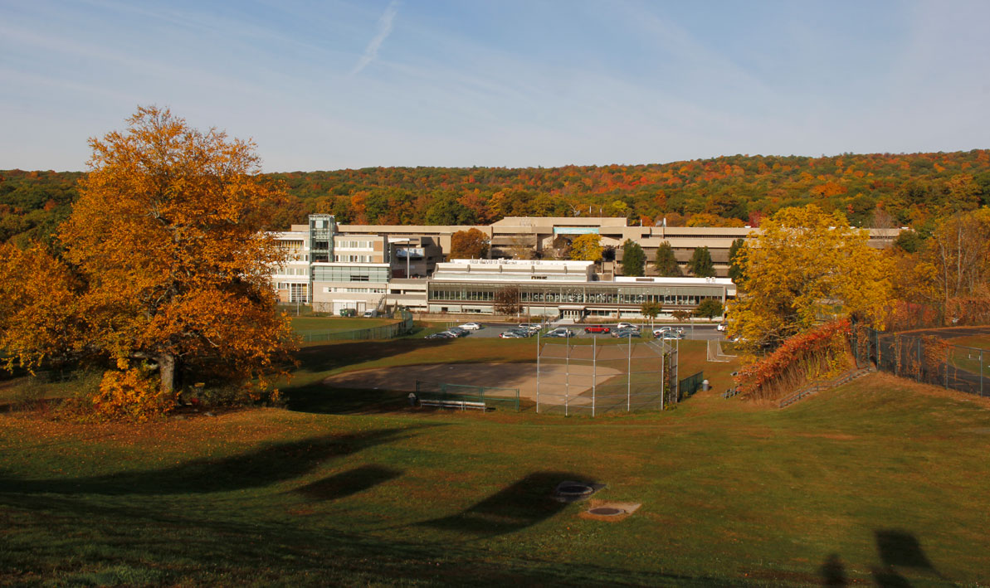
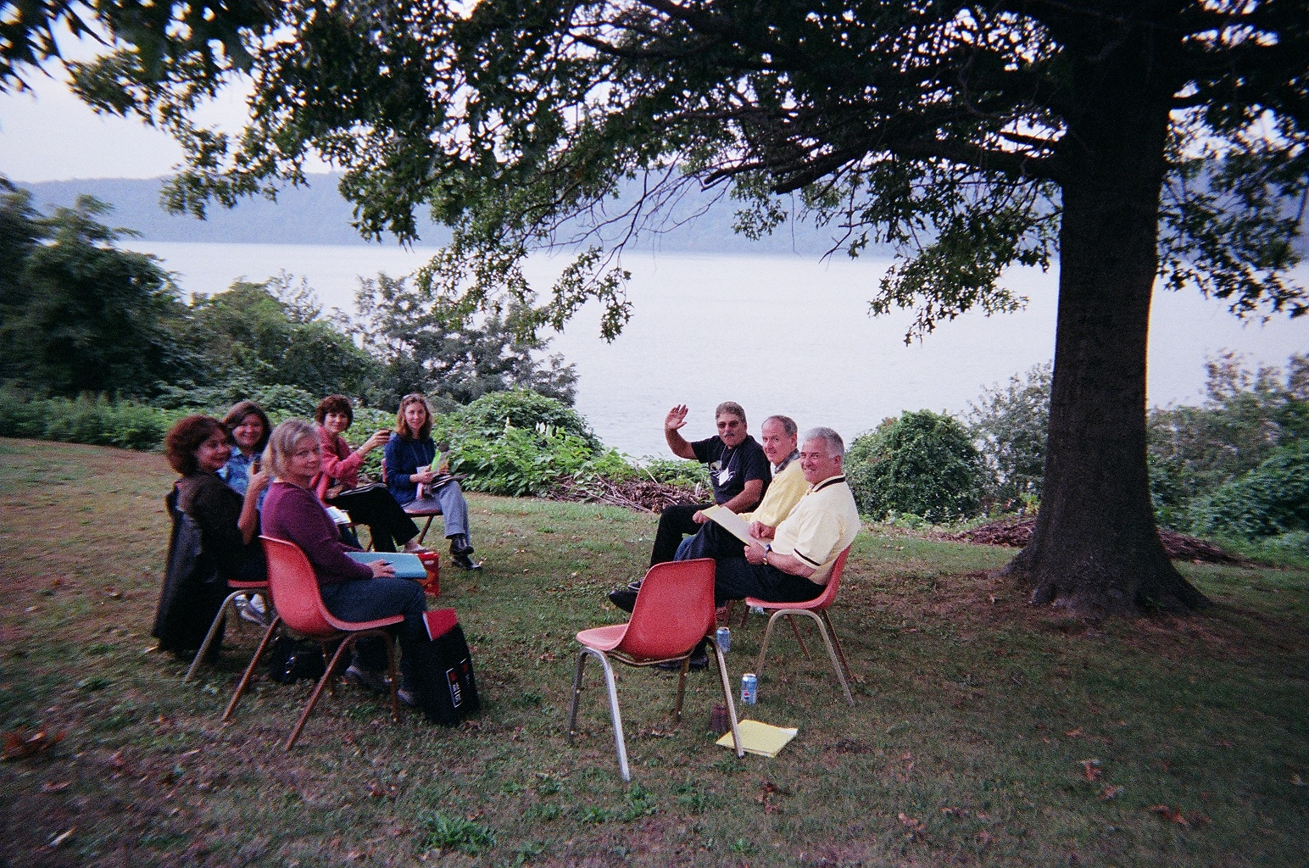
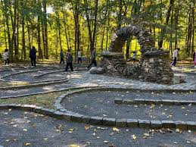

Slide 3
Community: Our Constant
Through many political seasons
Through many social challenges
Through many changes in academia

Slide 4
“The key goals for learning communities are to encourage integration of learning across courses and to involve students with ‘big questions’ that matter beyond the classroom. Students take two or more linked courses as a group and work closely with one another and with their professors. Many learning communities explore a common topic and/or common readings through the lenses of different disciplines. Some deliberately link ‘liberal arts’ and ‘professional courses’; others feature service learning.”
AAC&U 2025

Slide 5

Why?
Increase curricular coherence
Promote deep learning
Connect skill and content areas
Build community
Revitalize faculty
Revitalize the institution
Promote diversity
Enhance student engagement
Enhance student achievement
Increase retention

Slide 6
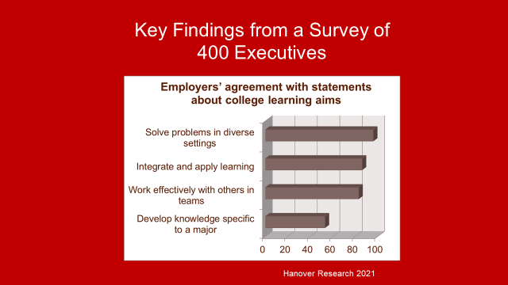

Slide 7

Career-Readiness Competencies
Communication
Critical Thinking
Teamwork
Leadership
Equity and Inclusion
NACE 2025

Slide 8

The Challenges of 2025…
Political
Social
Higher Ed

Slide 9


Grounded together…
…through community

Slide 10

Our Call
Continuing our work with courage so as to form students of community and conviction…
…
The power of courage and community

Slide 11
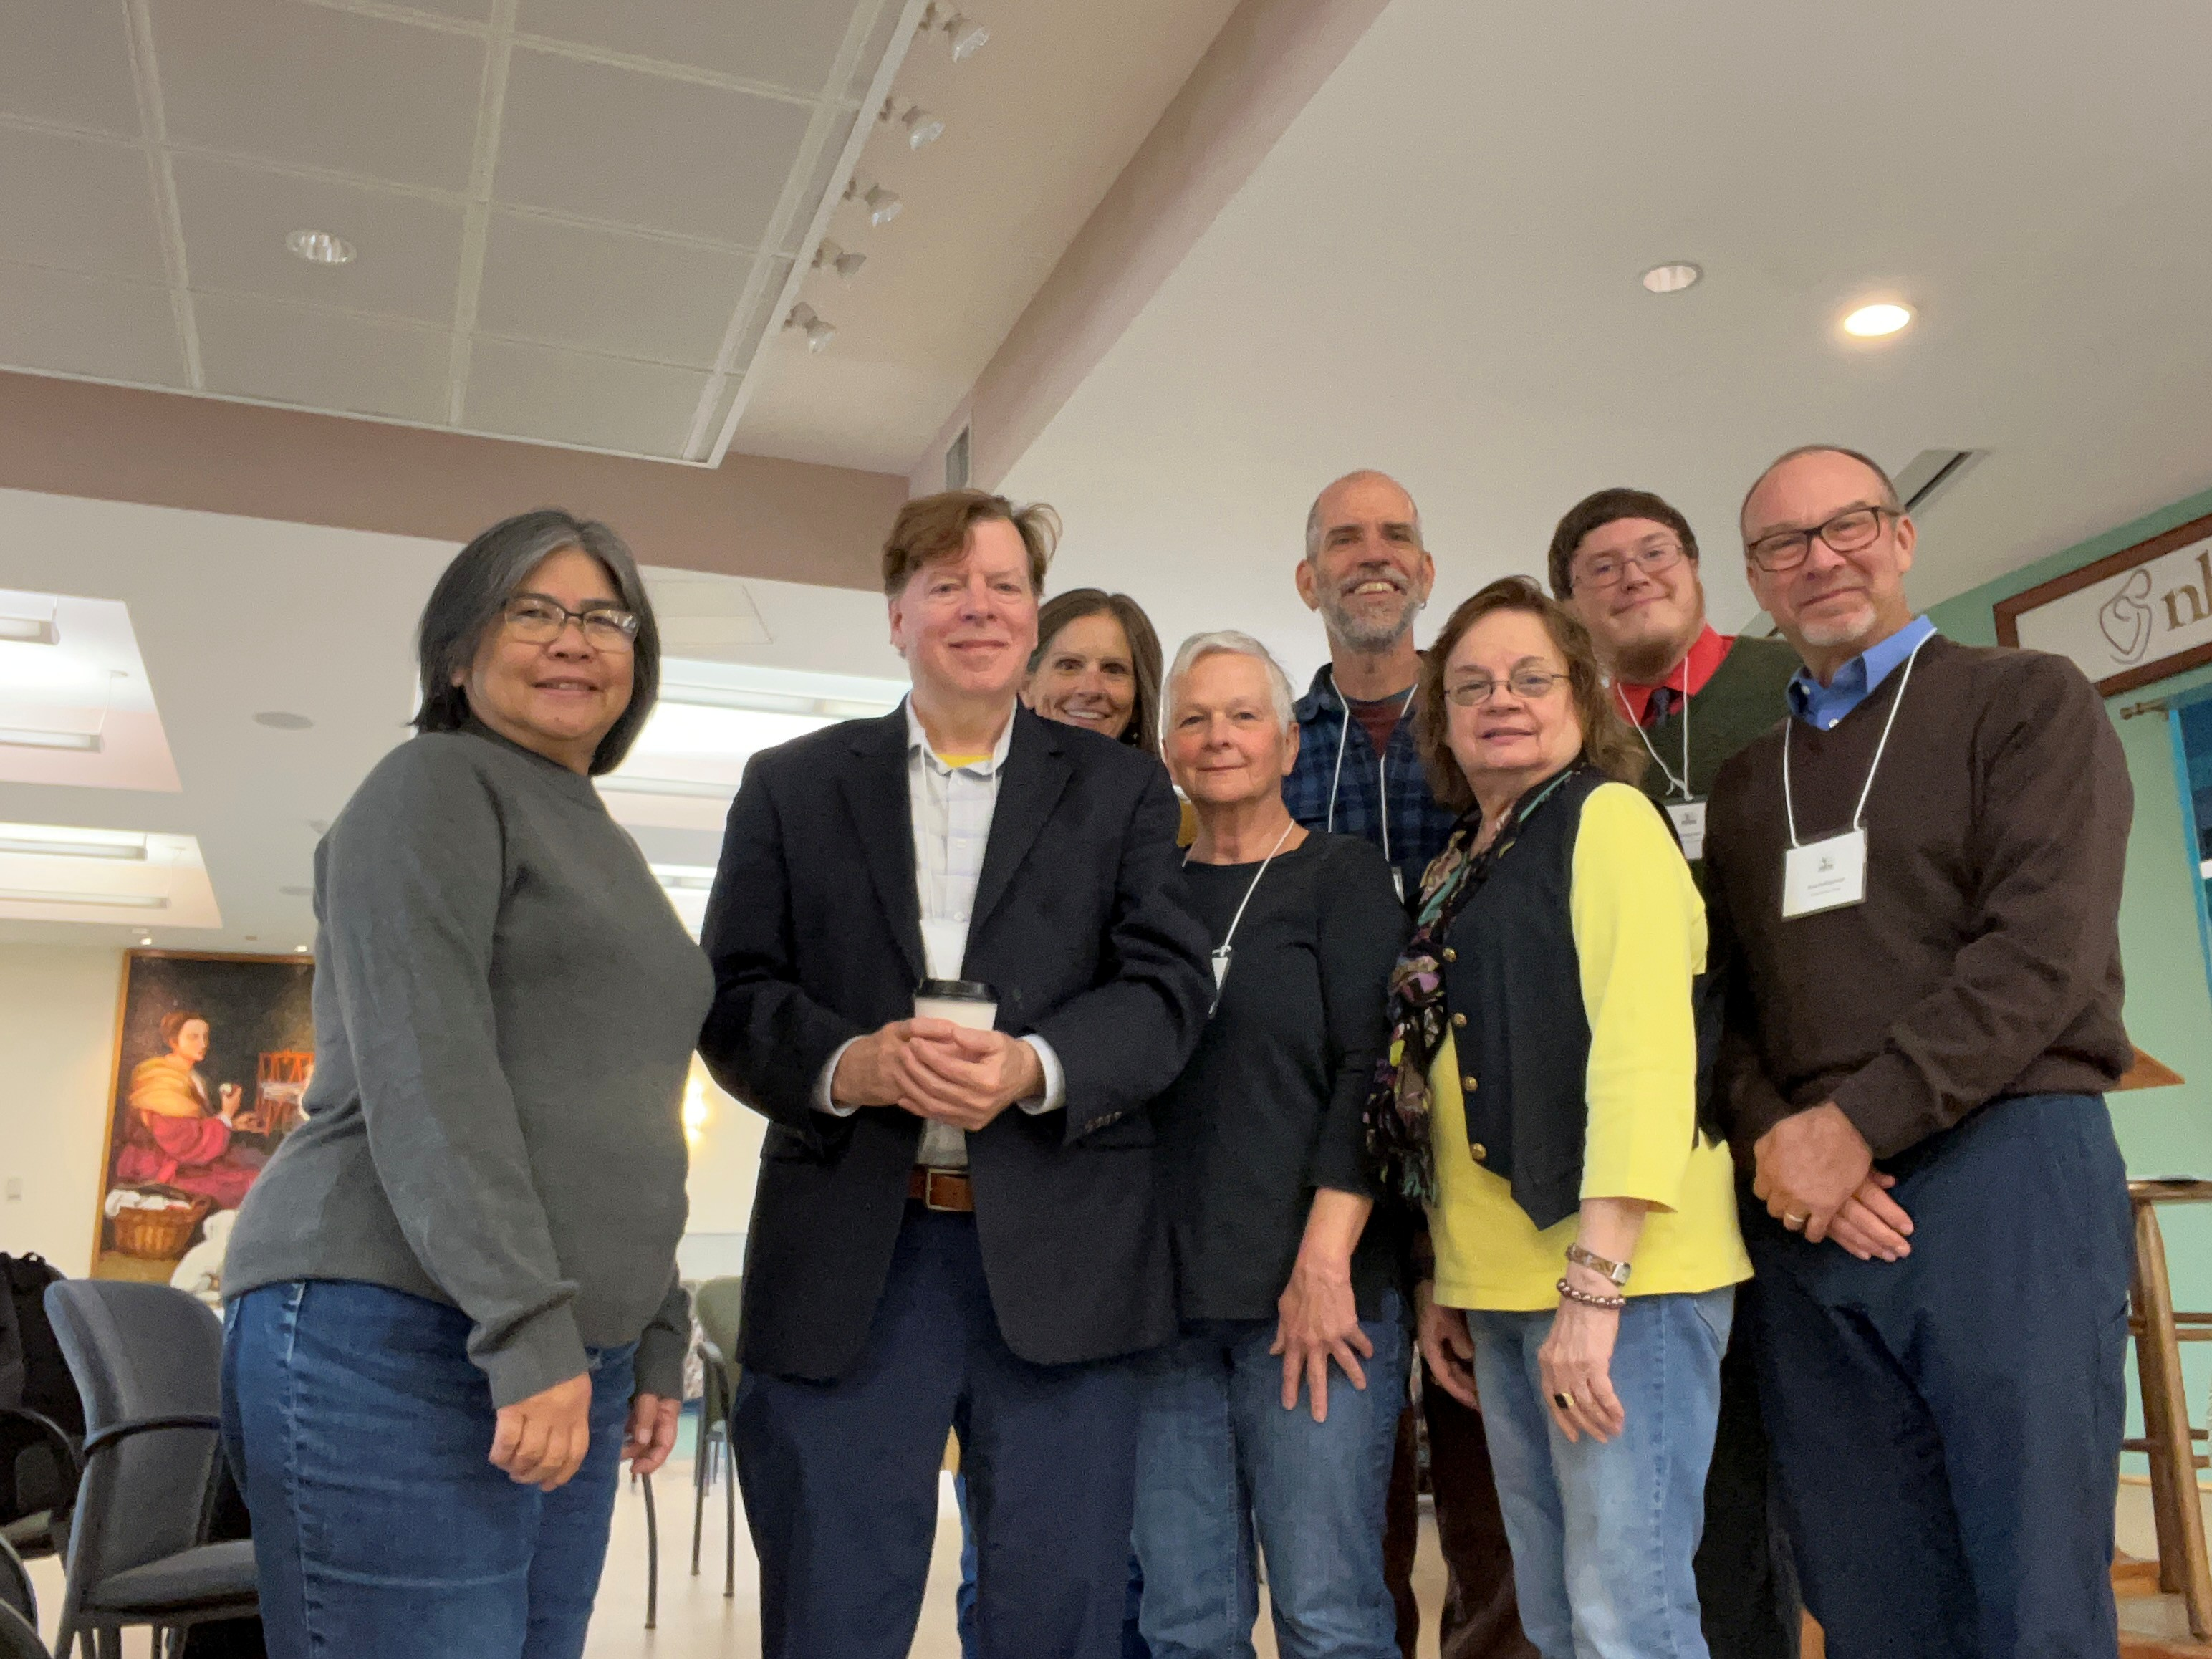
Better Together…
https://youtu.be/7rZyI7kPZMI?si=e6vx40lC7o2e-i-G

Slide 12


