Slide 1

LC 101: Developing and Implementing Learning Communities
Atlantic Center for Learning Communities Retreat
October 2023
Brad Hollingshead, Ph.D.
Dahl & Lottie Pryor Endowed Chair in English
Florida Southern College
bhollingshead@flsouthern.edu
Rebecca Tumposky, MA
Director of Learning Communities
Bunker Hill Community College
rtumposk@bhcc.edu
Art by Favianna Rodriguez
Notes:
Becca

Slide 2
Goals for Today
Ground in Learning Communities theory and practice
Articulate a “Why” for building Learning Communities
Identify partners to be on LC development team
Learn about resources for LC development and implementation
Notes:
Becca–really looking forward to the day, learning from and with each other, take a look at the goal for today; take a look at these and turn to a partner next to you–which one is most interesting relevant to you. when you see my hand go up, i will ask you to do two things–raise your own hand which will help others notice we are coming together, then the harder thing is to bring your conversation to a close.

Slide 3
INTRODUCTIONS IN PAIRS
1
Your Name/Institution
2
Why Learning Communities at your institution?
…OR What do you hope to gain from this workshop?
Notes:
Becca–Turn to the person next to you: strengths you can build on, obstacles you may face

Slide 4
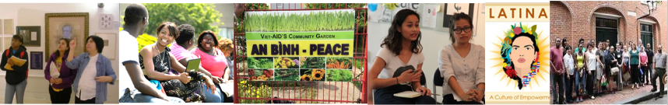
What Learning Communities do
Organize faculty and students
Encourage integration of the curriculum
Establish academic and social networks
Focus faculty and students on learning outcomes
Offer a critical lens for examining the first year experience
Shapiro & Levin Creating Learning Communities 1999
Notes:
Becca–

Slide 5
Goals and Purposes of Learning Communities
Increase curricular coherence
Promote deep learning
Connect skill and content areas
Build community
Revitalize faculty
Revitalize the institution
Promote diversity
Enhance student engagement
Enhance student achievement
Increase retention
Notes:
¨Brad–

Slide 6
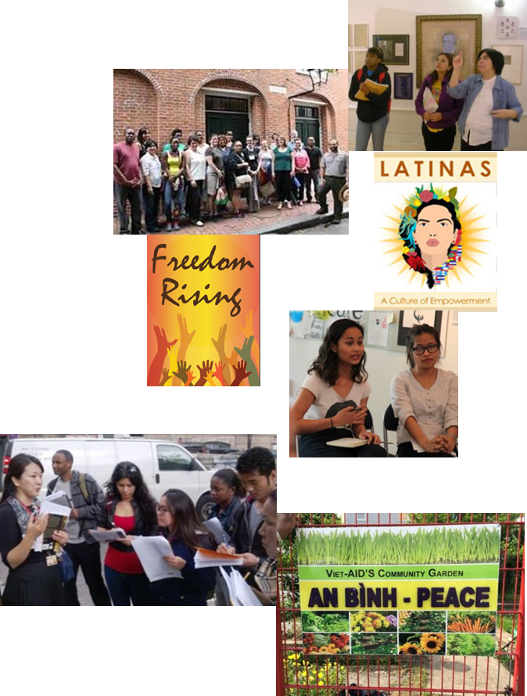
Key Characteristics of Learning Communities
Link or cluster courses and faculty around an interdisciplinary theme
Enroll a common cohort of students
Foster explicit intellectual connections between:
  Students and students
  Students and faculty
  Faculty and faculty
Notes:
Brad

Slide 7
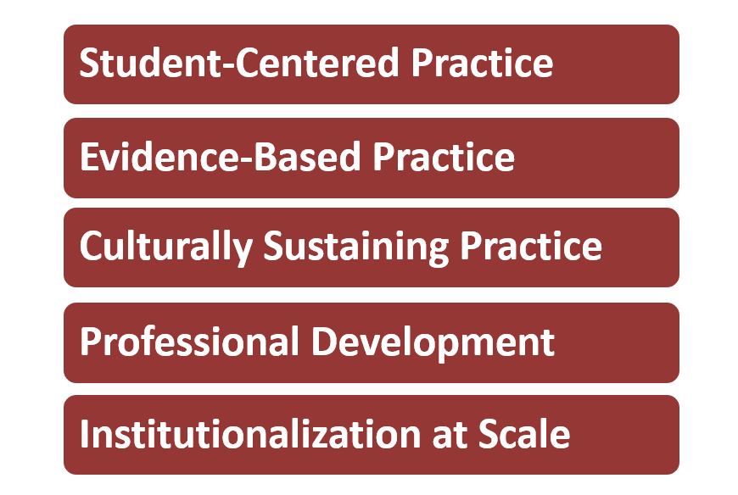
Core Learning Community Practices
Notes:
Brad

Slide 8
Factors that Enhance Student Learning
  Increased amounts and quality of interaction (Astin)
    Student-student , student-faculty
    Study outside of class
  High levels of involvement and engagement (Kuh, NSSE)
    Academic challenge
    Active learning
    Student-faculty interaction
    Supportive campus environment
    Enriching educational experiences
    Astin, A. (1993). What matters in college? Four critical years revisited. San Francisco: Jossey-Bass.
    Kuh, G. D. et al., (2005). Student success in college: Creating conditions that matter. San Francisco: Jossey-Bass.
Notes:
Brad

Slide 9
Centering Equity
“…we have learned to view inequality in educational outcomes as a problem of student underpreparedness, not a problem of practitioner knowledge, pedagogical approaches, or “culturally held” ideas about minority students… It is far more likely that practitioners will attribute inequality in educational outcomes to student deficiencies than question their own practices.” (Bensimon, 2007, p. 456)
Notes:
Becca
talk about being student-ready college rather than students ready for college; this course is critical to that project
–what does this mean for you as a teacher–i am part of this institution, how am i making myself student-ready? thank you for sharing

Slide 10
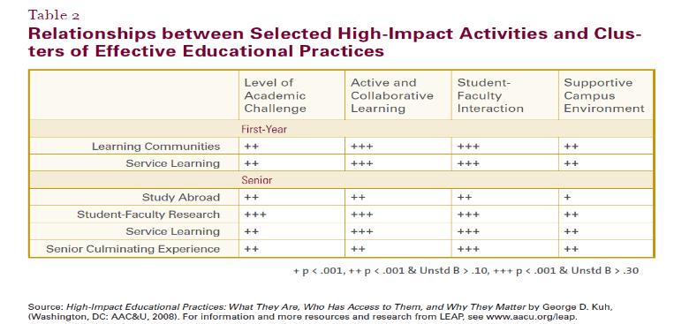
Outcomes of Learning Communities
Notes:
Brad

Slide 11
Articulate Your “Why”
What do you believe that Learning Communities could accomplish for students, faculty, the institution, and the broader community?
Notes:
Becca–Pair with a different person

Slide 12
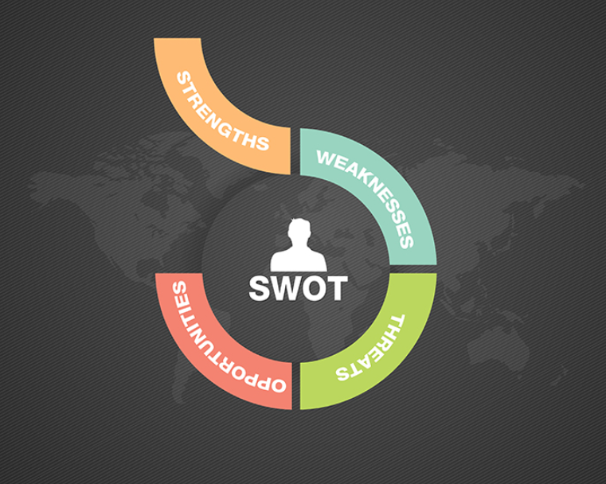
How will LC’s advance your institution’s strategic priorities?
Notes:
Becca Work in Pairs (15-20 min)

Slide 13
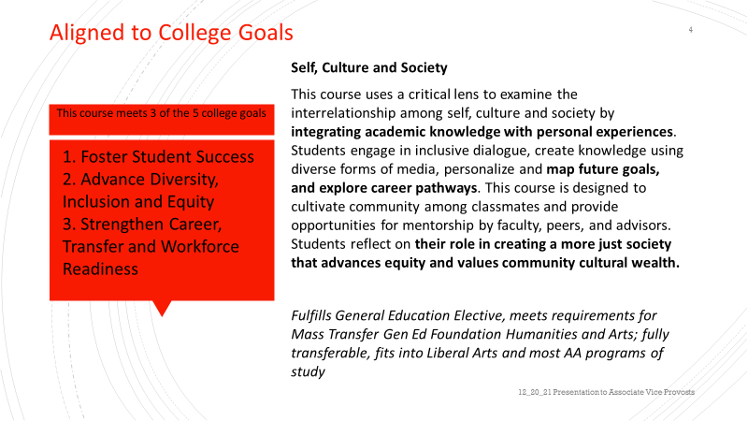
Example: Bunker Hill Community College
Notes:
Becca

Slide 14

Creating a Learning Communities Action Plan
What are some of the action steps to take when you return to campus in . . .
  One week?
  One month?
  Three months?
  Six months?
Notes:
¨Brad–

Slide 15
Building a Team
Faculty
Academic administrator (“champion”)
Librarian/Information Literacy
Academic advisor
Registrar
Student affairs administrator
Students (peer mentors)
Notes:
¨Brad–

Slide 16
2. Assessing Resources Needed
  People – faculty, administrators, staff, students
  Space/facilities
  Money
  Time
  Programs
  Other
Notes:
¨Brad

Slide 17
Faculty Engagement Strategies
Emphasize new opportunities
  Work across disciplines
  Work with a different population of students
  Innovation – new teaching methods, different topics, different texts and assignments/assessments, new scholarly opportunities
Possible perks – release time, stipend, equipment, visibility
Get department chairs on board
Recruit from across campus, seek diversity and wide representation
Notes:
¨Brad

Slide 18
Outreach/Marketing
Admissions officers
Academic advisors
Student affairs colleagues - orientation, residence life
Communications colleagues - website, brochures, news, FaceBook, Twitter, etc.
Other faculty and admins. – don’t keep it a secret
Notes:
¨Brad–

Slide 19
LC Resources
The Washington Center at Evergreen State College
  http://wacenter.evergreen.edu/?
The Journal of Learning Community Research and Practice
  http://washingtoncenter.evergreen.edu/lcrpjournal/
Research on LC development and effectiveness
  http://www.mdrc.org/project/learning-communities-demonstration#featured_content
LC bibliography
  https://atlanticcenterforlearningcommunities.org/contact/
Learning Communities listserv
  http://www.freelists.org/list/learningcommunitiesassociation
Notes:
Brad

Slide 20
Sample LC Webpages
Participating institutions of the Atlantic Center for Learning Communities
(ACLC):
  https://atlanticcenterforlearningcommunities.org/about/
The University of Washington
  http://fyp.washington.edu/figs/
Delta College
  https://www.deltacollege.edu/academics/academic-support-programs-and-communities/learning-communities/about-learning-communities
New Century College at George Mason University
  https://www2.gmu.edu/academics/new-century-college
Notes:
Brad–

