Slide 1

Incorporating Wellness Practices into the Classroom
Sue Maxam, Ed.D.
Asst. Provost for Wellness
Pace University
ACLC Retreat
October 2023

Slide 2
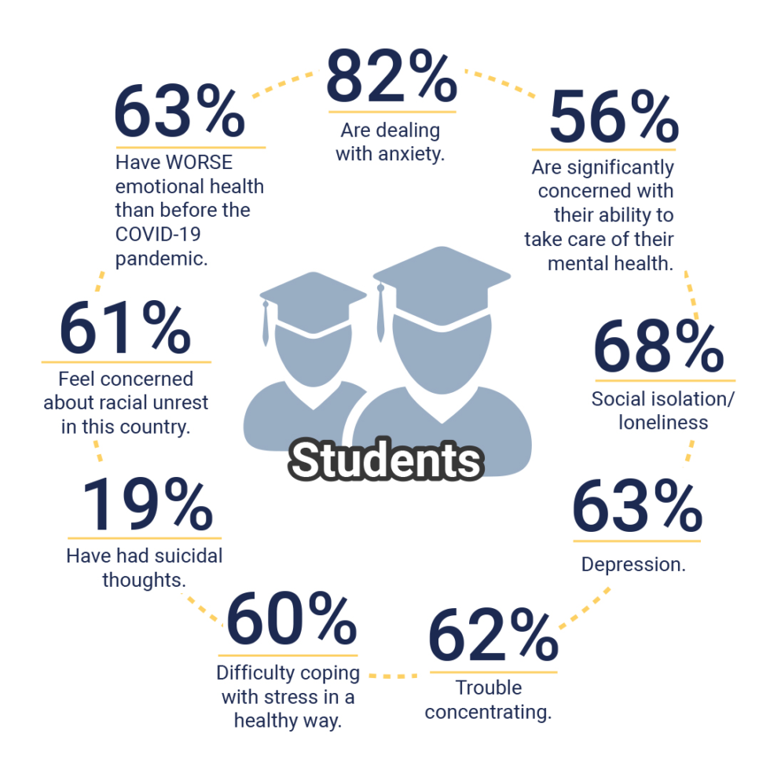
Impact of College Students’ Mental Health Challenges
Mental health issues experienced by college students have reached new heights over the past few years, with 7 in 10 students experiencing stress, anxiety or depression (APA, 2022).
Mental health issues being among the top reasons students leave college (TimelyCare, 2023).
In the last year, more than 30% of college students were diagnosed and treated for anxiety, and 22% for depression (TimelyCare, 2023)

Slide 3
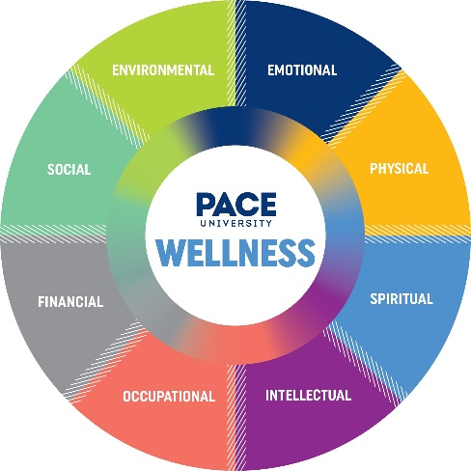
Classroom Impact on Holistic Student Wellbeing
Faculty play a key role in promoting a life of balance and wellness in our students.
The classroom provides an important venue for faculty to connect students with resources that can support their wellbeing, resilience, and effective learning.
By showing a genuine interest in a student’s life, making a connection with them on items outside of the classroom, and displaying authentic respect for their autonomy of learning, students feel a sense of community.
Creating opportunities for personal growth in course design can help increase students’ skills, resilience, and career-readiness.
An inclusive learning environment demonstrates an intentional consideration for all students and can enhance wellbeing.
Setting a caring tone can go a long way toward helping students feel they belong.

Slide 4

Best Practices, Cont.
Learn the names of your students.
Include ways for students connect with each other such as through small group discussions; group assignments; etc.
Give students a short survey asking about their interests, hobbies, and strengths in addition to anything they are nervous/concerned about re: the class.
Have students write responses about their key takeaways are for each class and what they would like to learn more about.
Have students introduce themselves to the class (e.g., name, pronouns, major, year in school, interests, and how the subject may be relevant to them).

Slide 5

Best Practices, Cont.
Display a genuine interest in a student’s life, make a connection with them on items outside of the classroom, and display authentic respect for them.
Craft intentional language included in syllabi that supports wellness and inclusion.
Structure assignments and due dates to promote balance.

Slide 6

Best Practices, Cont.
Create a positive, welcoming classroom environment, inviting connections and fostering open-mindedness.
Introduce yourself/background in your first class and learn a little bit about your students’ interests and background.
Create an ”equity-minded” syllabus that promotes student belonging and growth.

Slide 7
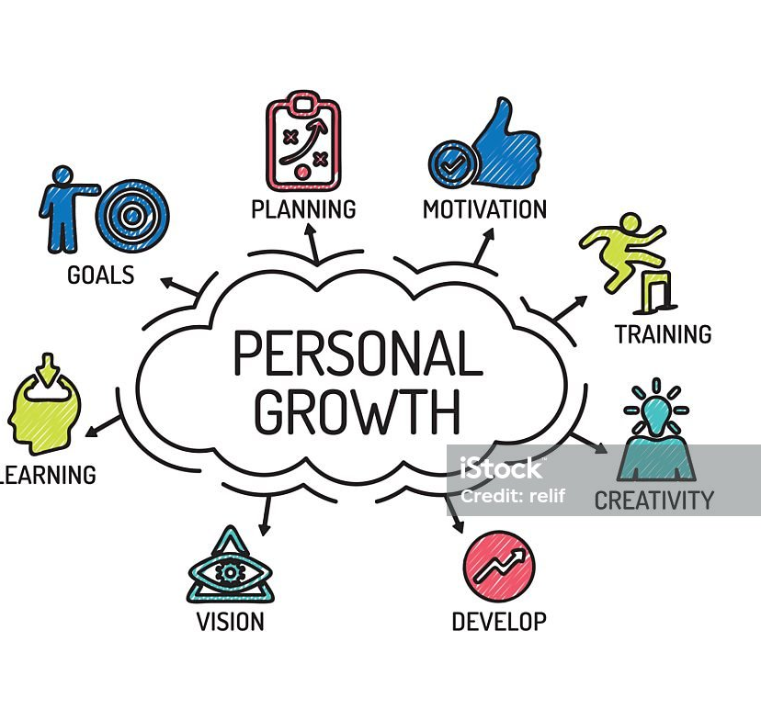
Best Practices, Cont.
Use journaling or other reflective activities to encourage personal growth.
Encourage students to seek co-curricular, volunteer, and internship opportunities.
Consider what skills students will need to succeed in life and in their careers and try to find ways to foster these in class (e.g., teamwork, communication, problem solving, empathy, initiative).

Slide 8

Best Practices, Cont.
Provide students with multiple ways to get in touch with you.
Facilitate interactions in and out of class to help create a sense of community and build their social networks.
Use a class check-in activity to connect with students (e.g., ask students to write 1 – 2 words about how they’re feeling that day in the chat box or a Poll Everywhere word cloud).

Slide 9

Best Practices, Cont.
Seek feedback from students throughout the semester. This could be done through Zoom polls or set up in Qualtrics.
In your syllabus, offer a variety of ways for students to contact you with questions or concerns.
Consider providing students with recording of the class, PowerPoints, videos, etc. (particularly helpful for ESL students who may need more time to understand what is being taught verbally).
Assign course materials written by authors they can identify with (e.g., first-generation, BIPOC, female, etc.).

Slide 10
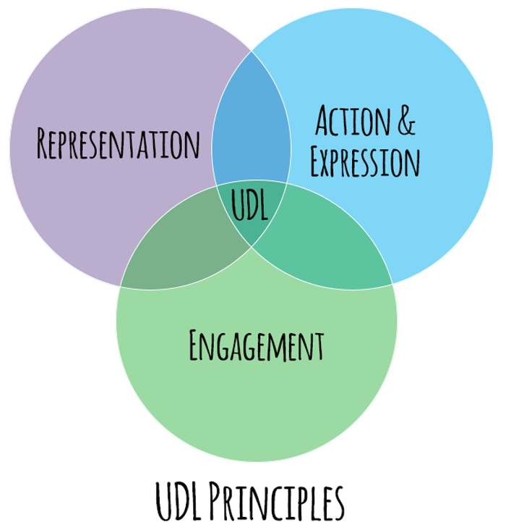
Best Practices, Cont.
Accommodate different learning styles by providing a variety of ways students can engage and participate in the lecture and learning, such as discussion boards, written reflections, oral presentations, etc. (See Universal Design for Learning).
Use activities and practices in class to help build your and your students' intercultural competence.
Use inclusive language and gender-neutral pronouns.
Pause and summarize or ask students to summarize in the chat.

Slide 11
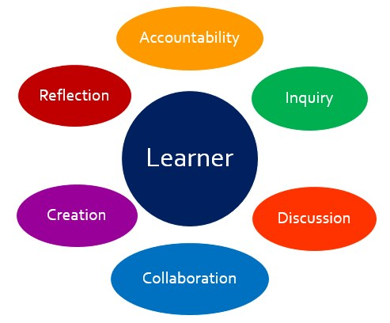
Best Practices, Cont.
Whenever and however possible, let students know you care about them and their success.
Demystify your role by sharing something about yourself.
Be learner centered – “be interested in learners instead of trying to be an interesting teacher.”
Provide constructive feedback and outline specific actions students can take to improve.
Consider the “whole student” and the pressures and challenges they may face outside of class.
Check in on students regularly through class check-in activities or individually via learning management system, email in person before/after class/during office hours.

Slide 12

Best Practices Cont.
Provide health tips or health resources in your course shell, syllabus, in class, and/or during breaks.
Remind your students about the importance of sleep and discourage all-nighters.
Use 2-3 minute mindfulness or relaxation recordings for a break.
30-40% of students experience food insecurity and students can’t concentrate if they’re hungry, so connect them to key campus resources for food (e.g., food pantry) and financial assistance.
In your syllabus and through class announcements, provide students with information on the various student support services.

Slide 13
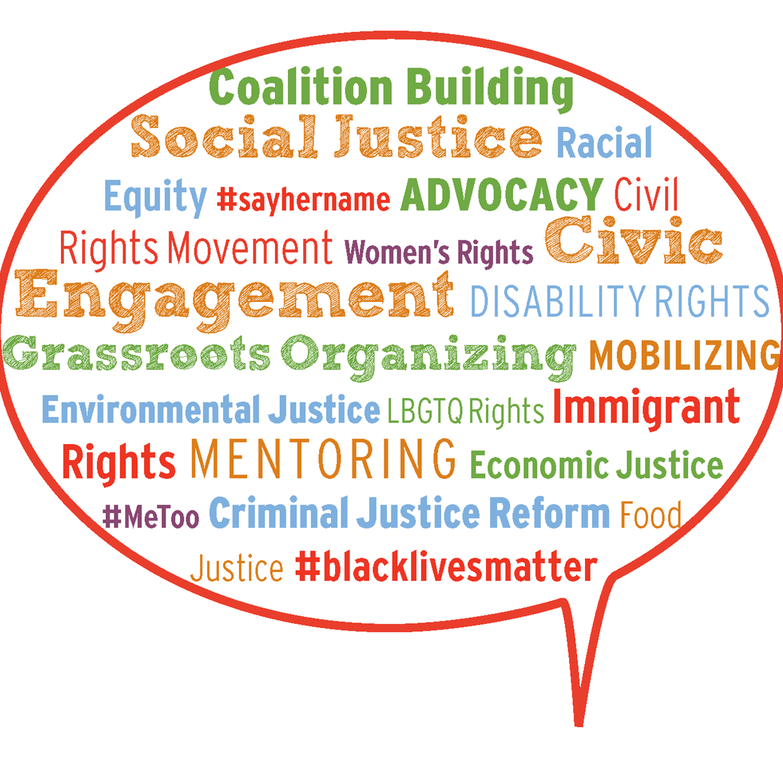
Best Practices, Cont.
Lead discussions or activities that help students develop a sense of civic responsibility.
Utilize examples from the real world in class to make the content more relevant to them (e.g., news clips, career advice, guest speakers from the workforce students hope to enter).
Create assignments in which the results can be utilized by a community group or campus initiative.
Where possible, incorporate experiential or service-learning components into your course.
Encourage students to get involved in extracurricular and/or volunteer work.

Slide 14
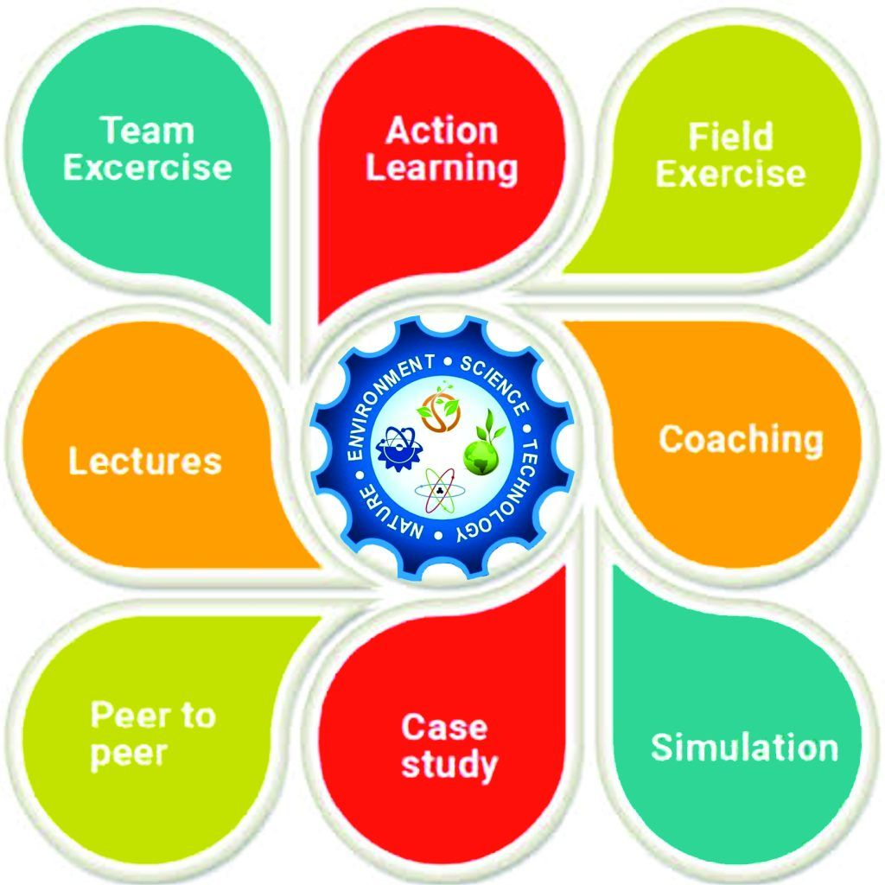
Best Practices, Cont.
Where applicable, provide feedback on each stage of a longer-term assignment (e.g., a term paper or group project).
Provide activities where students design mock test/study questions.
Give specific, targeted, and timely feedback about strengths and weaknesses.
Provide examples of exemplary work to communicate expectations and facilitate student understanding of the assignment and how it will be assessed.
Vary your teaching methods (e.g., class discussions, peer learning activities, problem-solving activities, videos, case studies, etc.). For example: College Mental Health (@.collegementalhealth) | TikTok

Slide 15

Outside Community Support Organizations
The Steve Fund: A nonprofit organization dedicated to supporting the mental health and emotional well-being of young people of color
RADical Hope Foundation: 4-week mental health, resilience and engagement program for college students (virtual or on campus)
Lady Gaga’s Born This Way Foundation: Programs and initiatives aimed at demonstrating the power of kindness to impact well-being, validating the emotions of young people everywhere, and eliminating the stigma surrounding mental health
Random Acts of Kindness Foundation: Free resources, programs and activities that promote kindness on college campuses and beyond

Slide 16

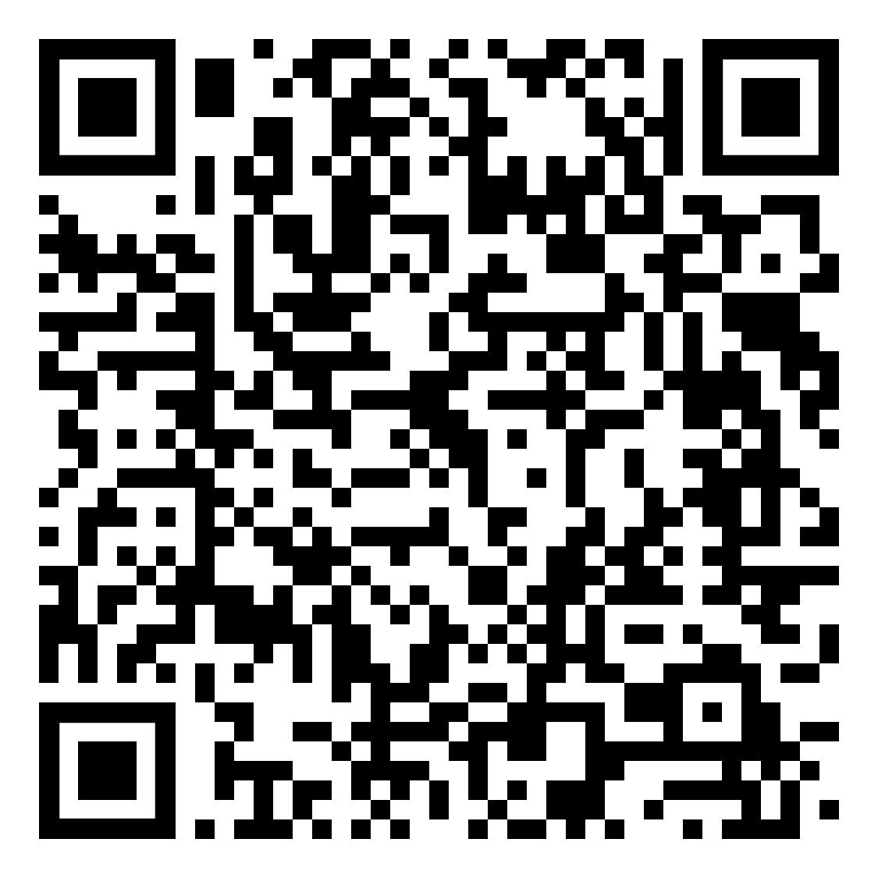
Let’s Jam!
https://jamboard.google.com/d/1sX2KmB3JvmdvEKr0a9pTYbKKYGoOH1EoSmUQF1ztT_E/viewer?f=0

Slide 17


