Slide 1
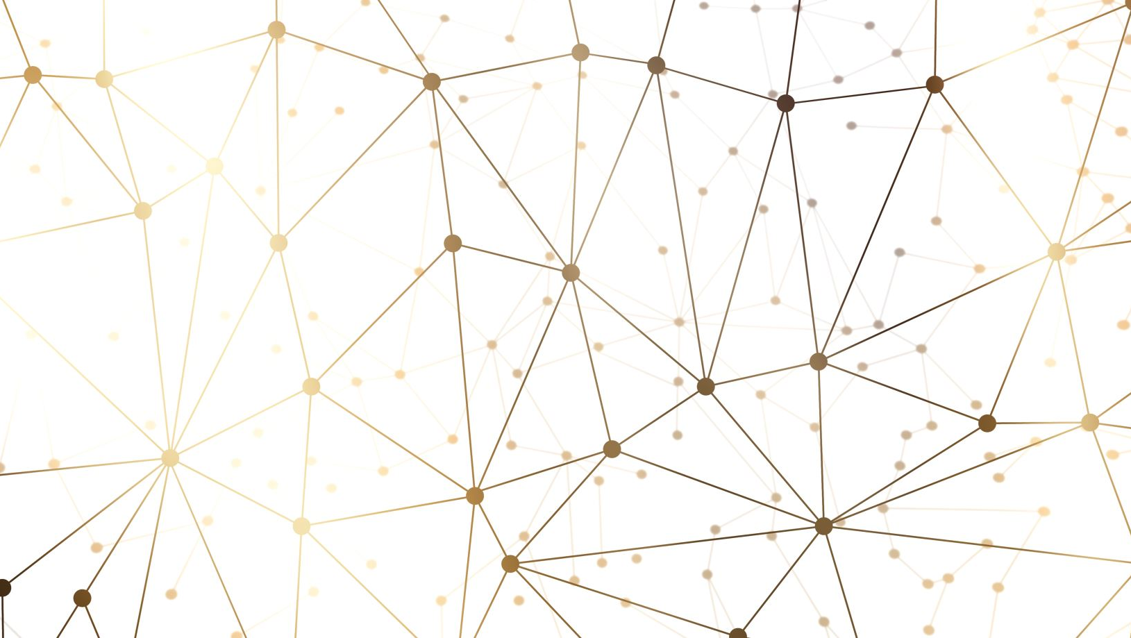
Building that village for learning and community
Building that village for learning Building that village for learning and community
Strategies and practices for creating community and engaged learning
Sandra Enos,
ACLC Curriculum Planning Retreat 2023
Sandra Enos, PhD

Slide 2
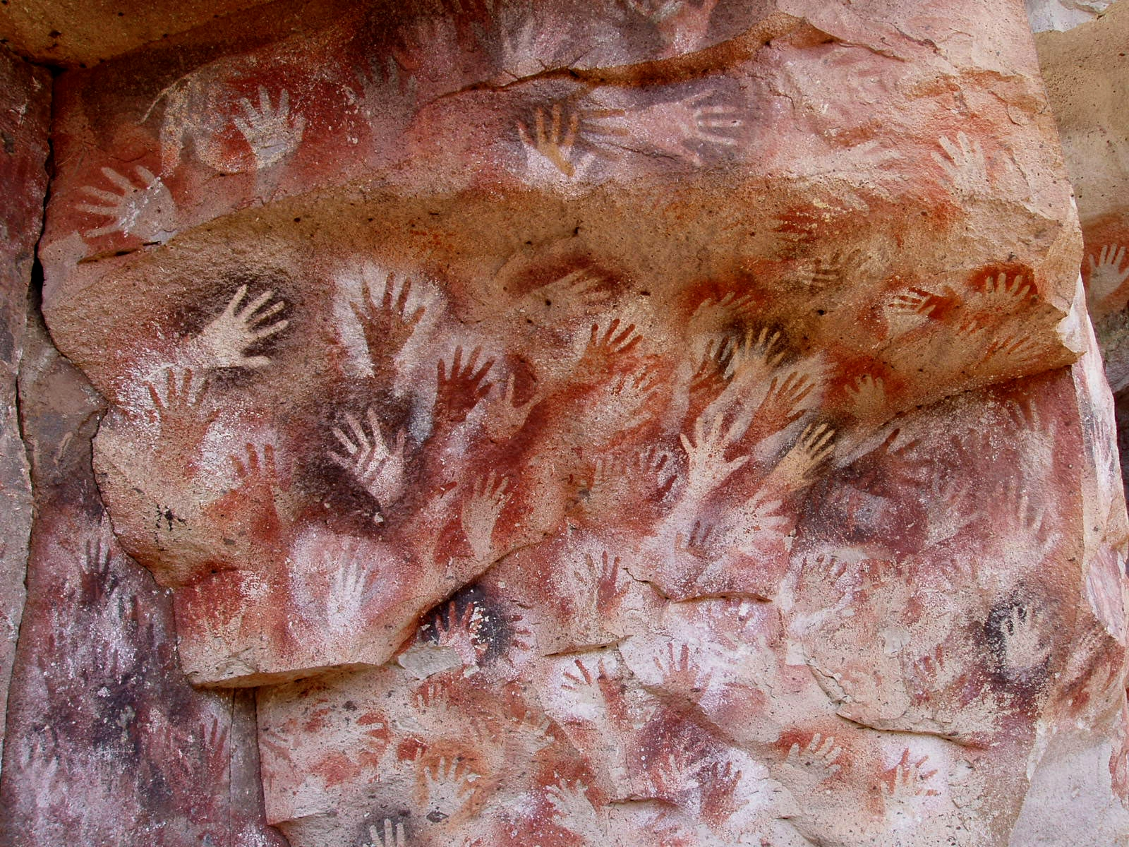

Slide 3

Lessons from improv
Fully present
Much to offer
Keys to success
Contributions to make
Our individual weirdness
Creating the stories of our lives together

Slide 4

Loneliness suspects
Social Media
Pandemic
Politics and political discourse
Membership organizations
Loss of trust
Fewer friends and social contacts
News diet
Loneliness and authoritarianism

Slide 5
Theory of Belongingness
In social psychology’s “theory of belongingness,” belonging is an innate motivational drive— underpinned by our ancestral origins—to form and maintain positive emotional bonds with others. Our need for belonging is so great that it permeates our thoughts, feelings, and behaviors, and is integrally connected to how we perceive and pursue our life goals.

Slide 6
From Belonging Barometer
Feeling emotionally connected
Being welcomed and included
Perceiving that one is able to influence decision-making
Feeling able to be one’s whole and authentic self
Being valued as a person and for one’s contributions
Being in relationships that are as satisfying as one wants them to be
Feeling like an insider who understands how the environment works
Feeling comfortable expressing one’s opinions
Being treated equally
Feeling that one “truly belongs”

Slide 7
Mattering
First: Does it matter if I show up? Do I feel invisible?
Second: Do I feel that others are invested in me? Is anyone invested in my welfare?
Third. Does it feel to me that other people can rely upon me? Can I be trusted? Do I feel like others value the contribution that I make?

Slide 8
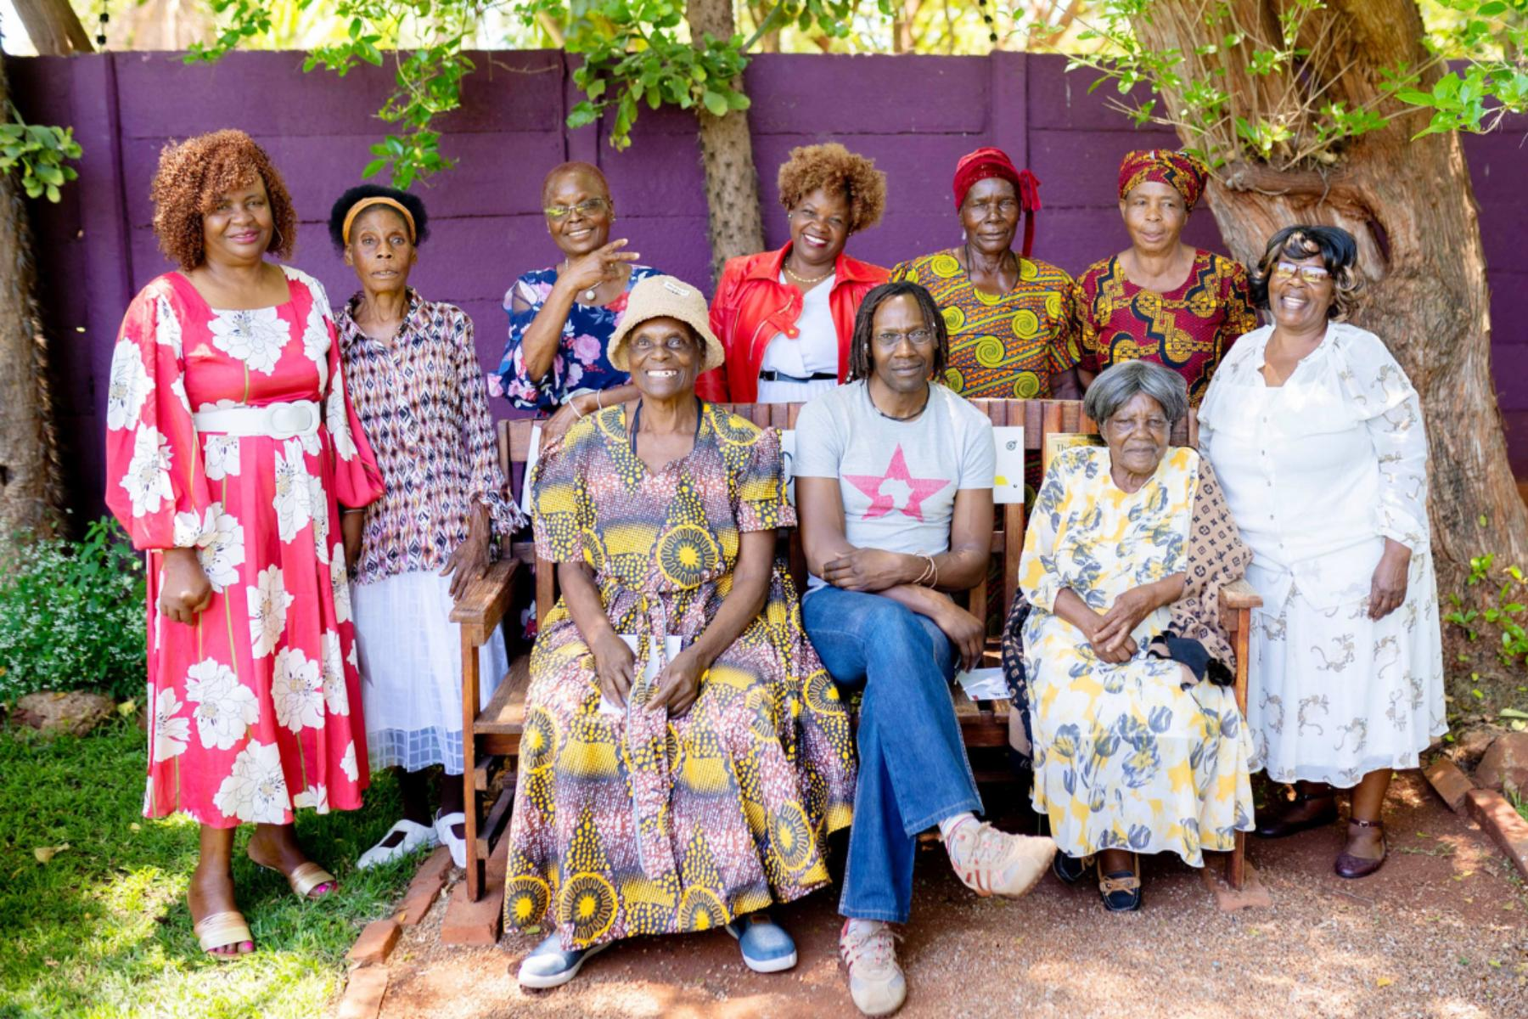
Zimbabwe’s therapeutic friendship benches
A legacy of poverty, genocide and dictatorship left Zimbabwe
struggling with an epidemic of depression,
colloquially known as kufungisisa, or ‘thinking too much’.
Enter the Friendship Bench: a landmark project that employs
grandmothers to deliver therapy in their neighbourhoods,
which is coming to cities around the world.

Slide 9
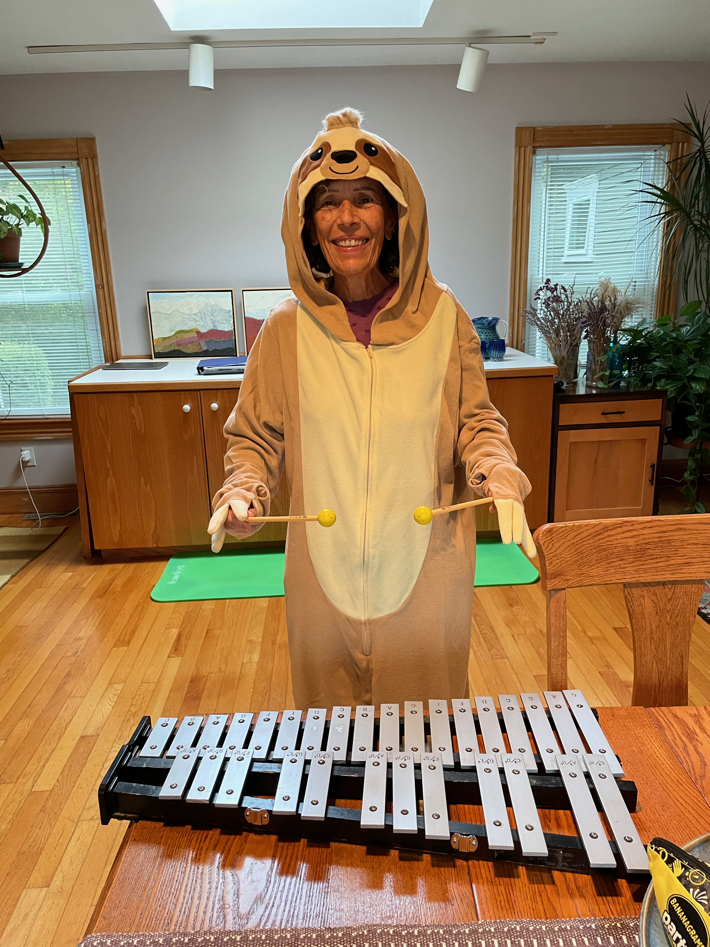
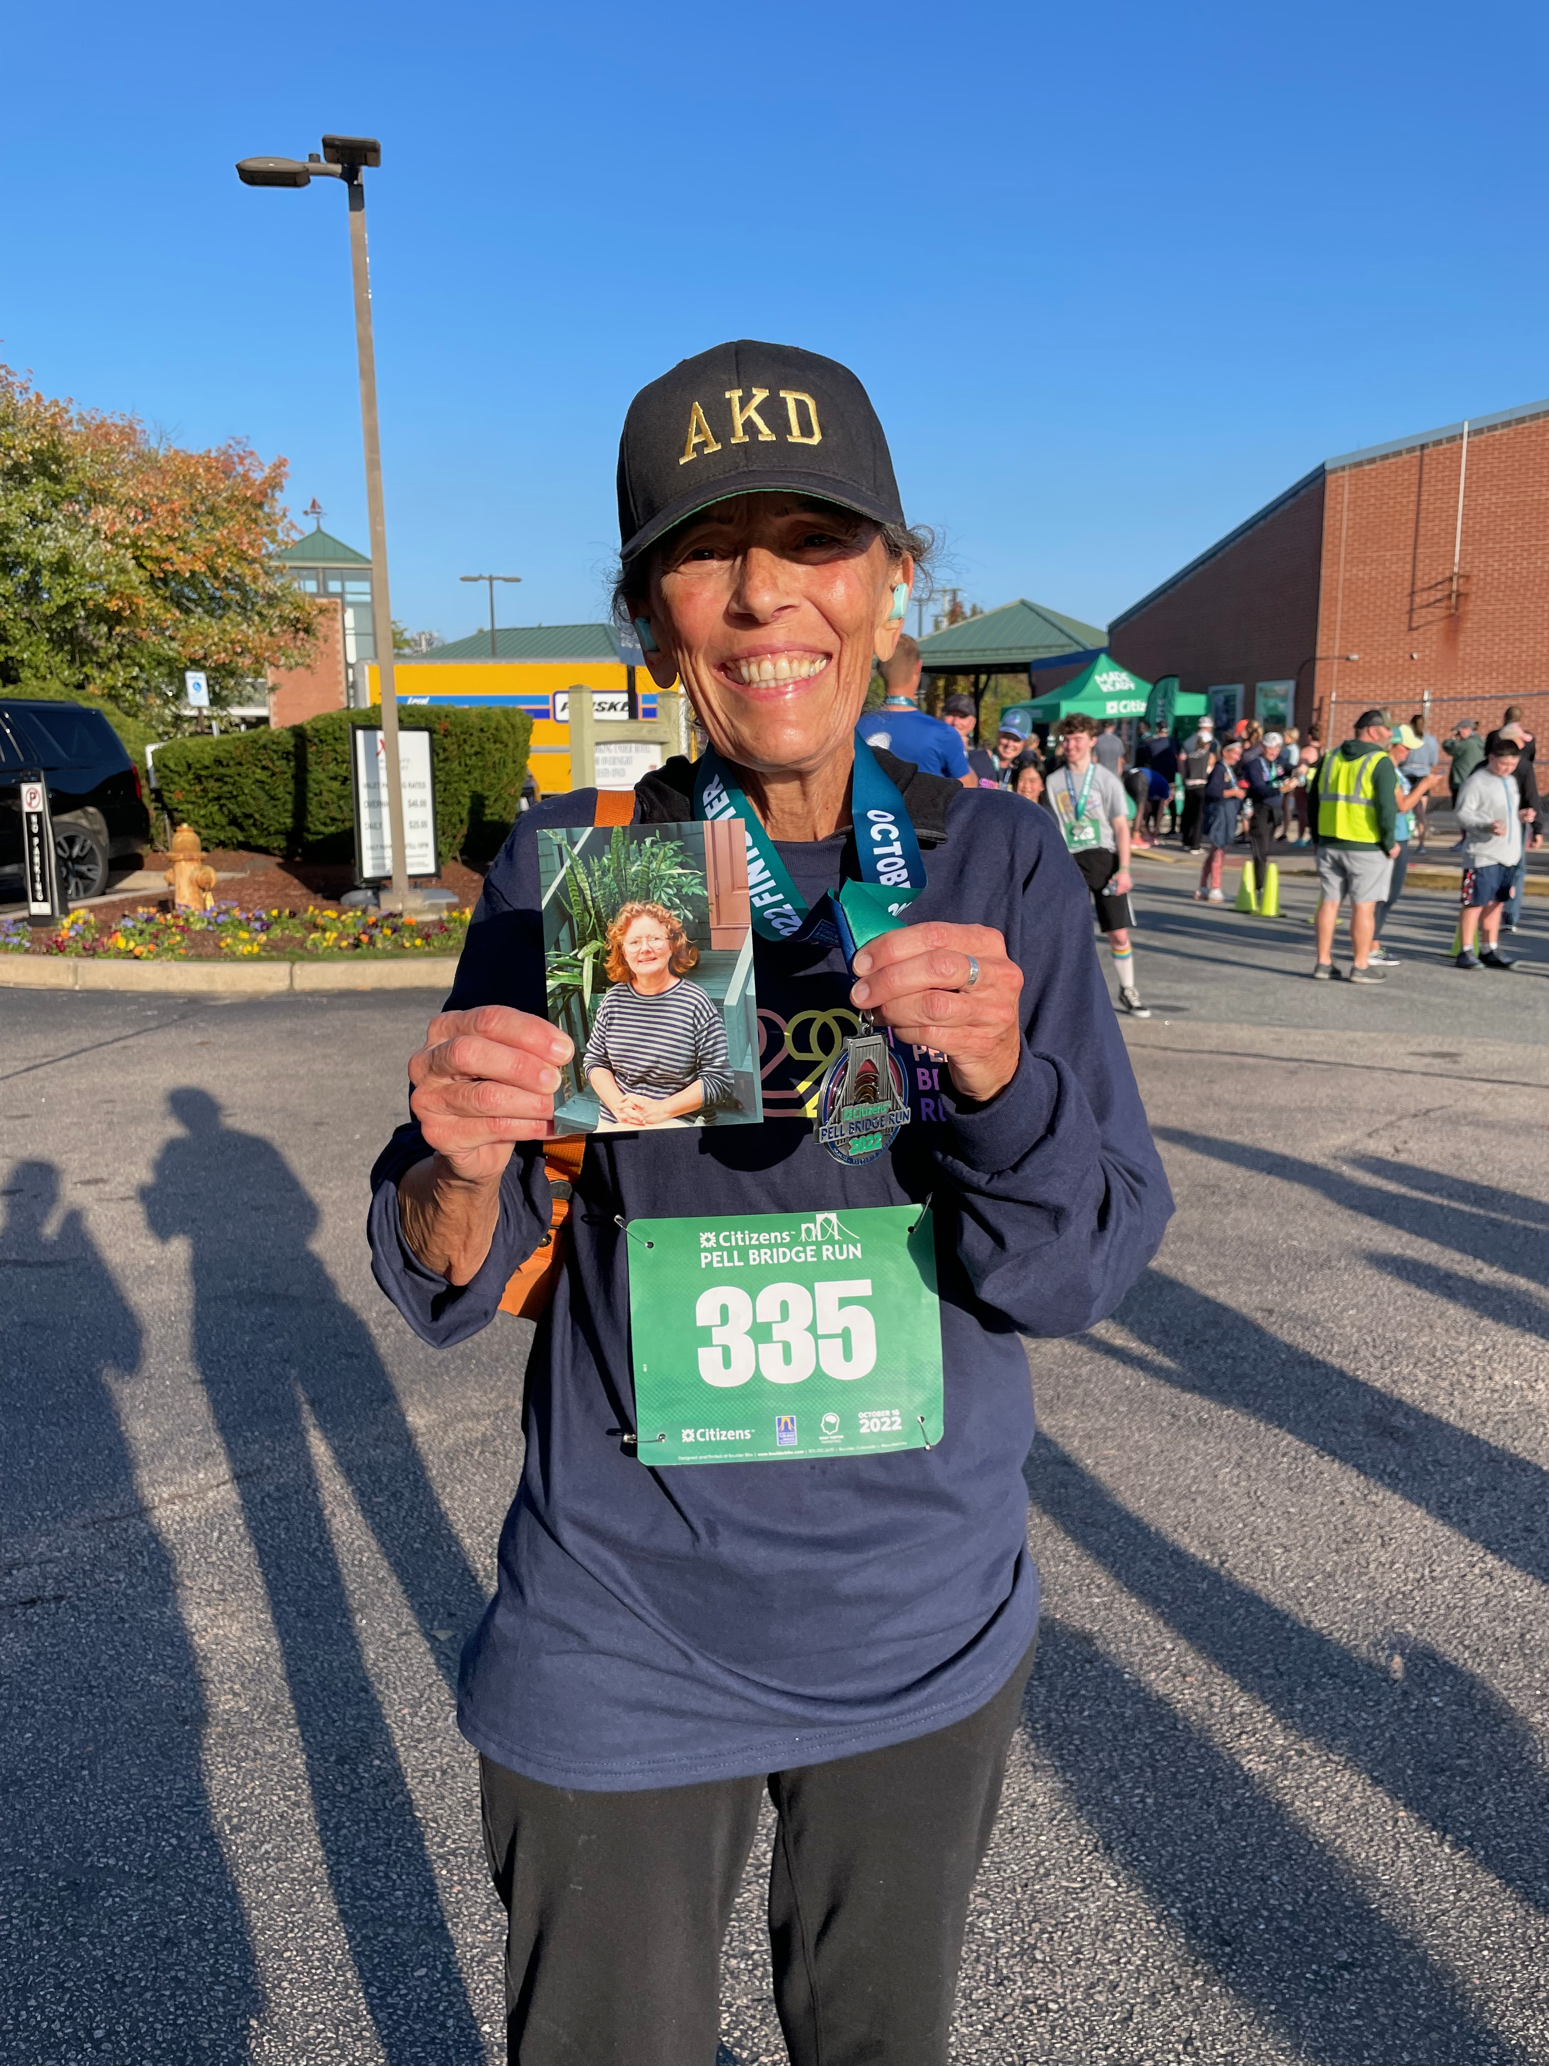
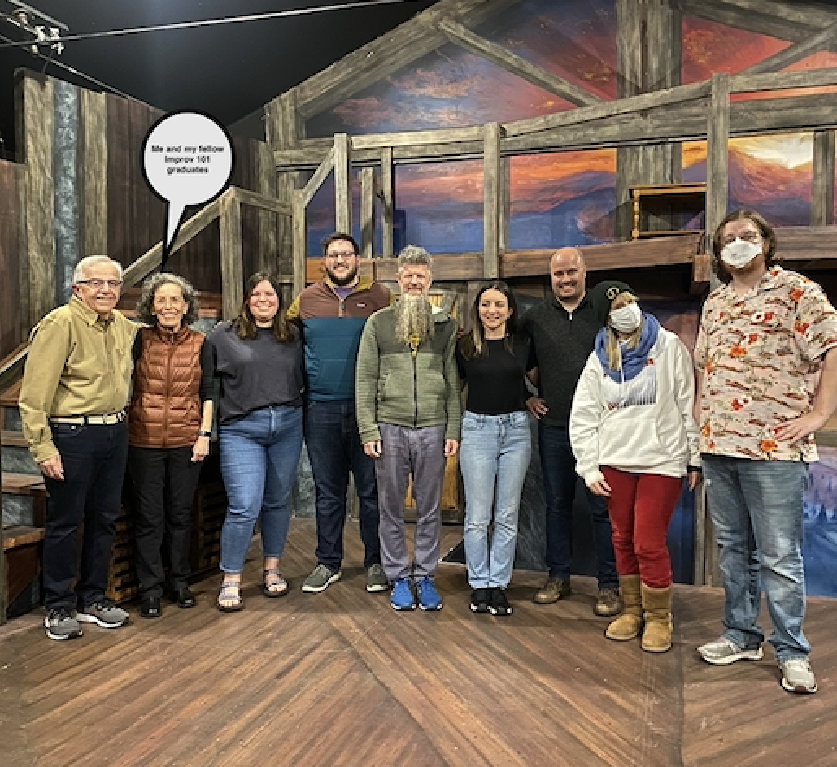

Slide 10
Lessons from improv
Fully present
Much to offer
Keys to success
Contributions to make
Our individual weirdness
Creating the stories of our lives together

Slide 11
Final notes
Please feel free to contact me if I can provide any support, brainstorming, references, resources, or crazy ideas.
Sandra.l.enos@gmail.com
Link to essay about improv on my blog
https://givingbeyondthebox.blog/2022/07/28/me-new-and-improvd/

