Slide 1
Harnessing Wrap-around Success: Reaching the Whole Student
George J. Hill
Senior Academic Advisor and Coordinator of Peer Mentoring
Kingsborough Community College

Slide 2
Who Are You?
What is your role in the Learning Communities you work with?
  Faculty
  Staff
  Administration
  Some combination of these
What other hats do you wear on campus?
  Are you a faculty member who also serves on committees, advises students, manages a student support program, etc.?
  Are you member of Student Affairs staff who also teaches?
  Are you an administrator who likes to keep teaching?
How do the students in your Learning Community perceive you?
  Do they primarily see you as “Professor _____” or in one of your other roles?

Slide 3
What challenges do your students face?
Academic
  Adjusting to the workload and pacing of college courses
  Dealing with different modalities (online, hybrid, in person, etc.)
  Preparation/the need for developmental coursework
Economic
  Need to work to pay for necessities like rent
  Commuting/geographic issues
  Financial Aid gaps
  Financial Aid Policies
  Food Insecurity/Homelessness
Physical/Mental Health
  Long-term/chronic conditions
  Emergency situations
  Trauma
  Adjusting to a Post(?)-Pandemic world
  Disabilities and the need for accommodations
Social
  Adjusting to Greater Independence
  Making new friends/adjusting to a new environment
  Dealing with prejudice

Slide 4
Where can students go for help with these challenges?
Tutoring Center/Writing Center
Financial Aid Office
Personal Counseling
Health Services
Academic Advising
The Access Resources Center
Library
Student Life
Residence Life

Slide 5
BUT HOW DO STUDENTS KNOW WHERE TO GO FOR HELP?
They usually have to ask someone…

Slide 6
Building in Supports to your Learning Community Program
Learning Communities are by definition collaborative, so you have a unique opportunity to use collaboration to help students.
At KBCC, all first semester Learning Communities include a Freshman Seminar course, SD-10.
The professor in this course is a Student Affairs Professional who serves as the Academic Advisor for all the students in the Learning Community.
Having the SD-10 professor be the students’ advisor helps them to know who to ask when they need help. Even if the advisor isn’t the right person to solve the problem, they can point the student to the appropriate place.
The SD-10 professor can also be a resource to the other faculty in the link, discussing policies or resources for students that faculty may not be as comfortable or familiar with.

Slide 7
Peer Mentoring – Because Sometimes we Just Need a Friend
Sometimes it’s hard for students to talk to their professors about challenges they are facing.
No matter how friendly or approachable you are, they still may feel intimidated. The same can be true for staff.
Having a well-trained Peer Mentor attached to the Learning Community is a great way to add an additional resource that students can connect with.

Slide 8
Peer Mentors Can:
Meet with students one on one or in small groups
Run Workshops/programs
Assist in Virtual Classes through Discussion Boards, Zoom lessons, etc.
Create materials for distribution to students
  Study Guides
  Tip sheets for being successful
  Podcasts, videos, etc.
Empathize with other students in a way faculty and staff can’t, since we are not currently students.
Meet in ways that may make students feel more comfortable opening up.
Talk about their own experiences using the resources that they would refer other students to.

Slide 9
Peer Mentors Should Not:
Replace Academic Advisors/other Professional Staff
Try to force connections with students
Have expectations that make it difficult for them to be students themselves
Go Rogue

Slide 10
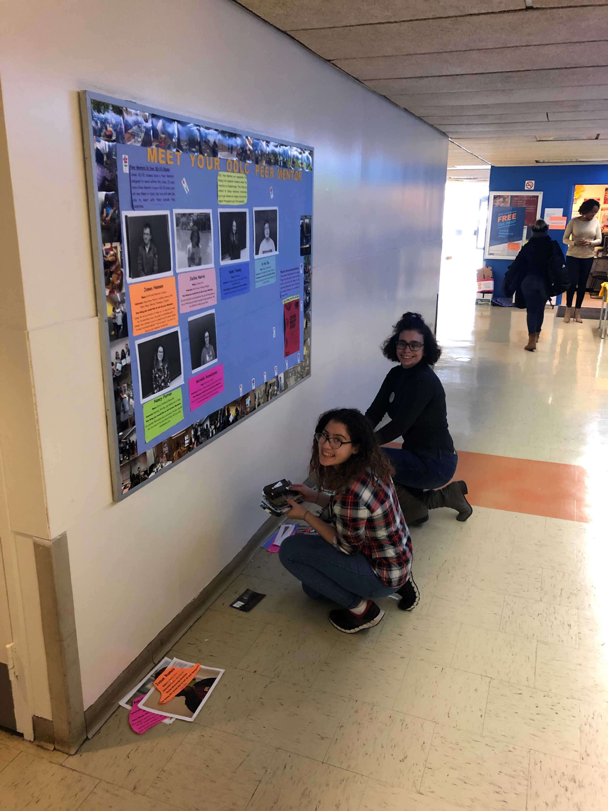
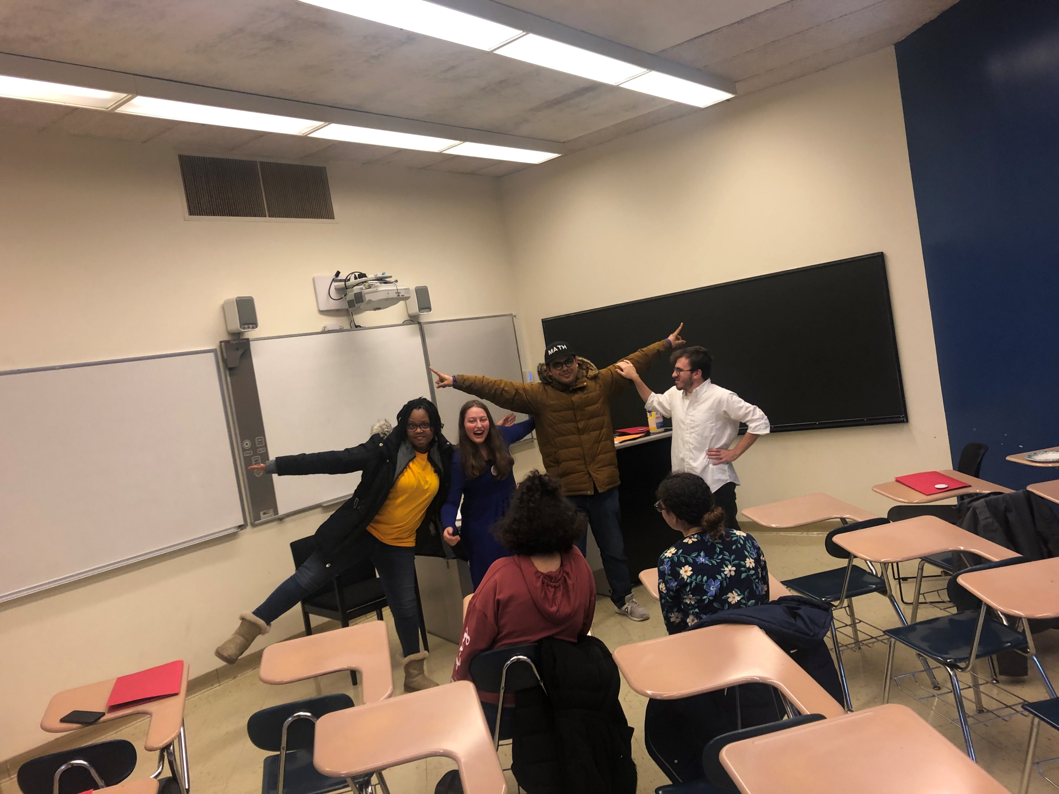
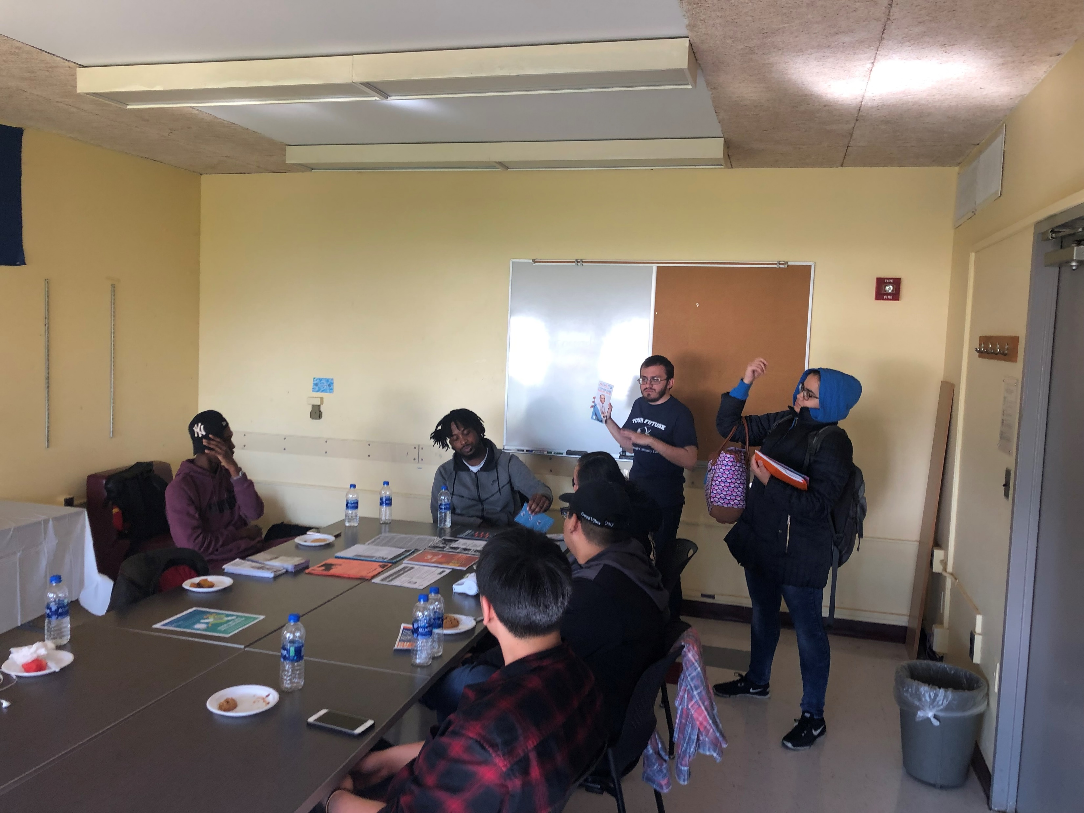
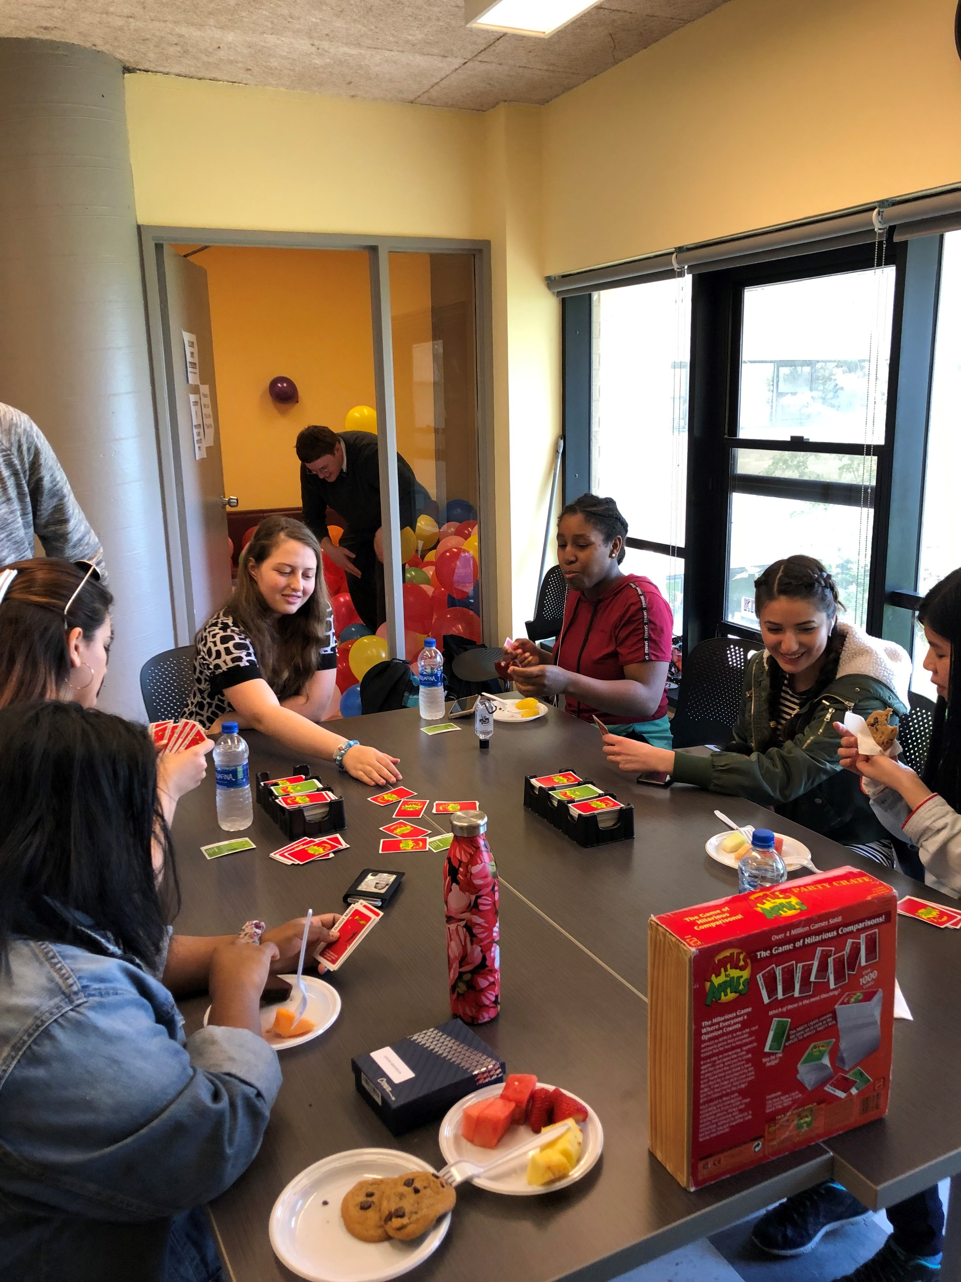
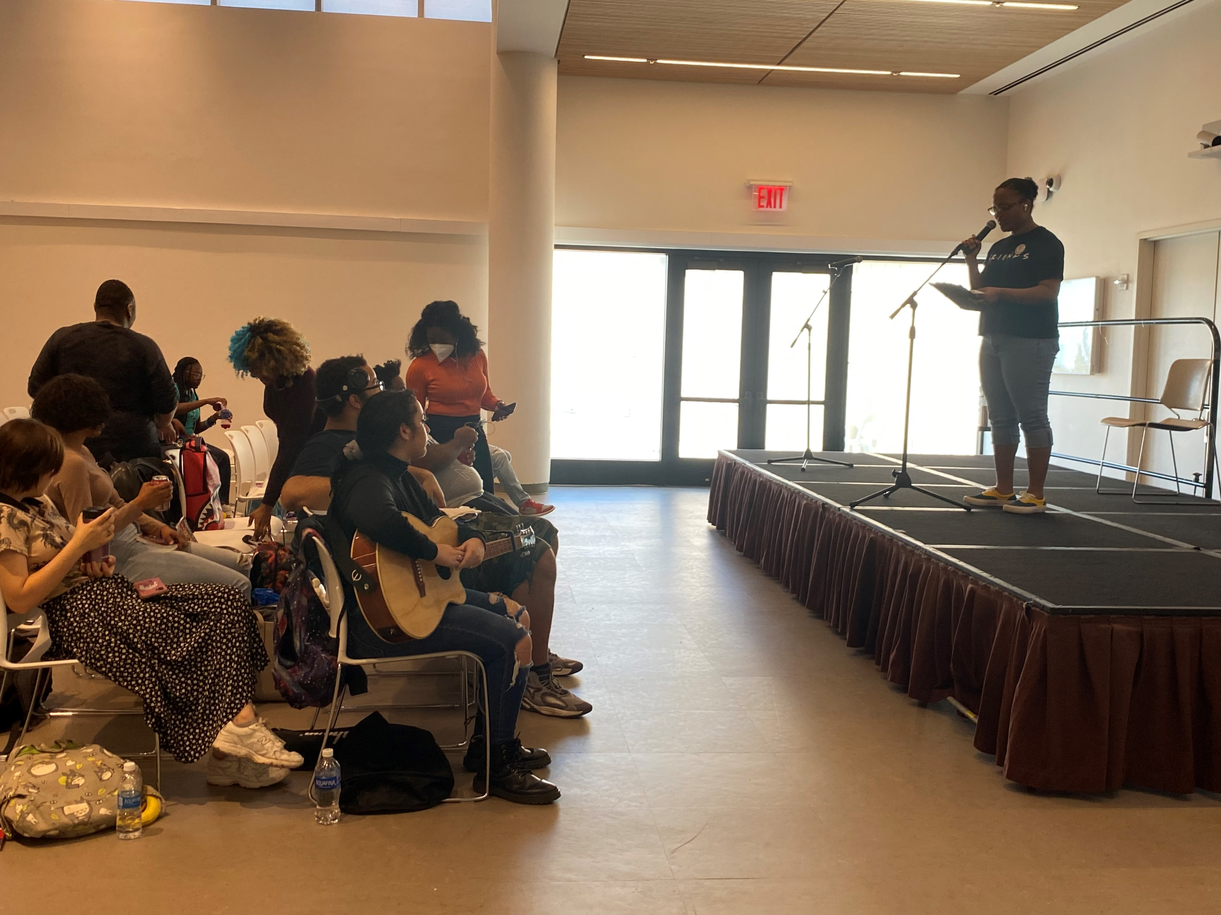
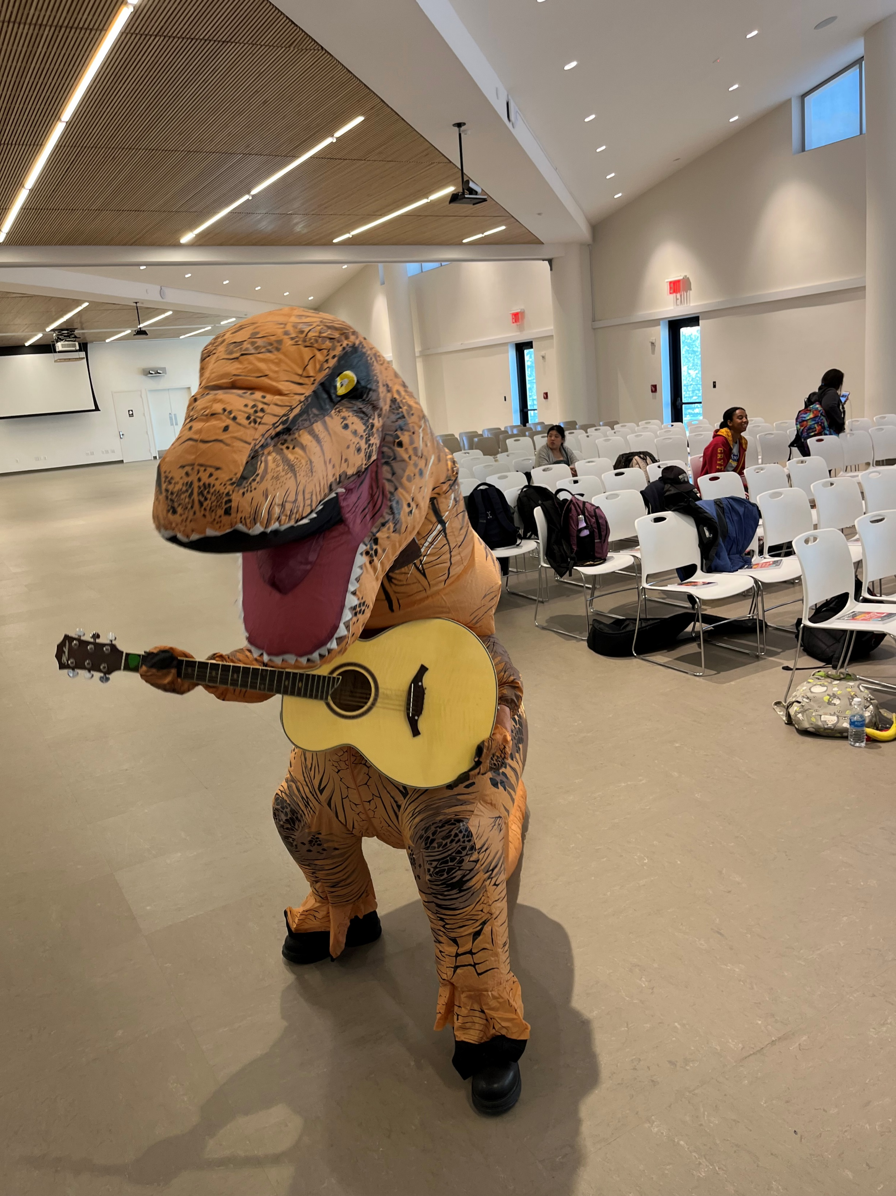
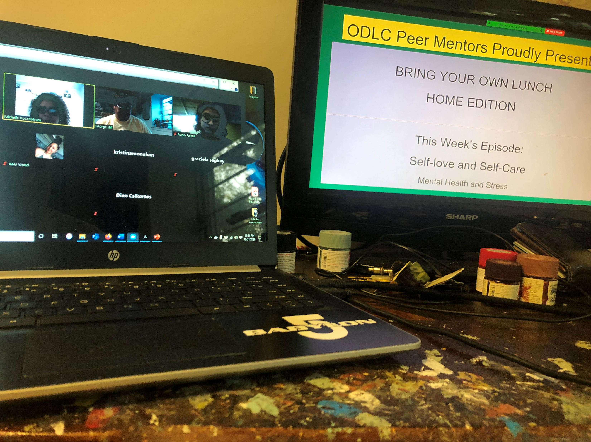
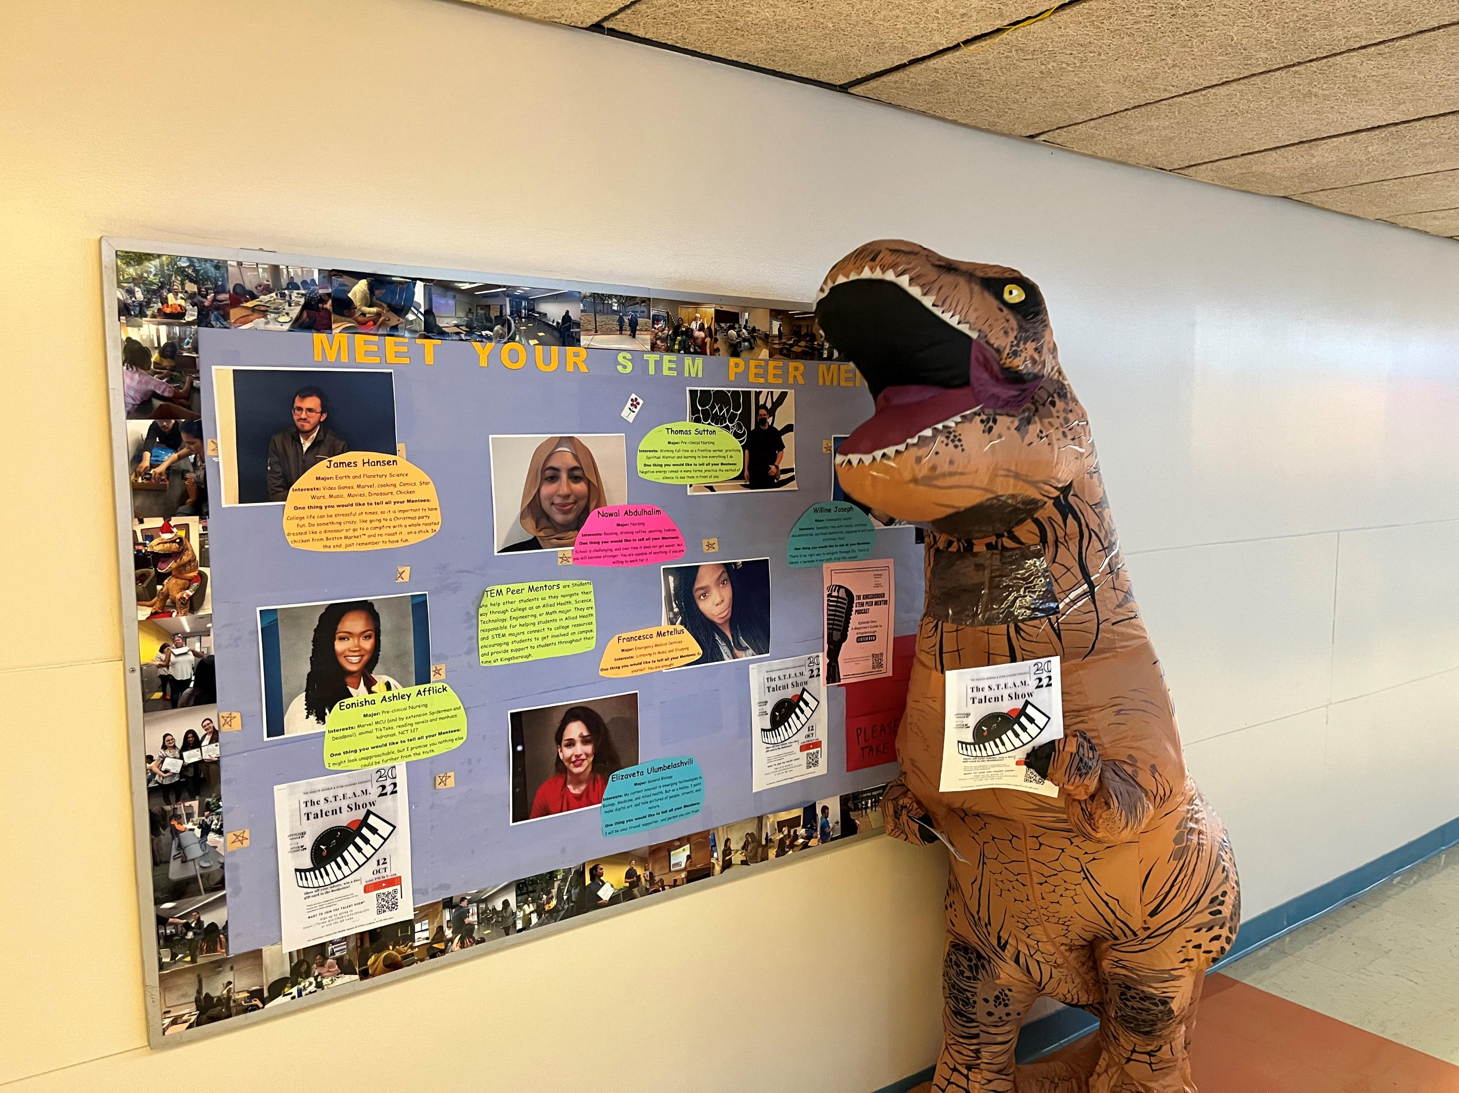
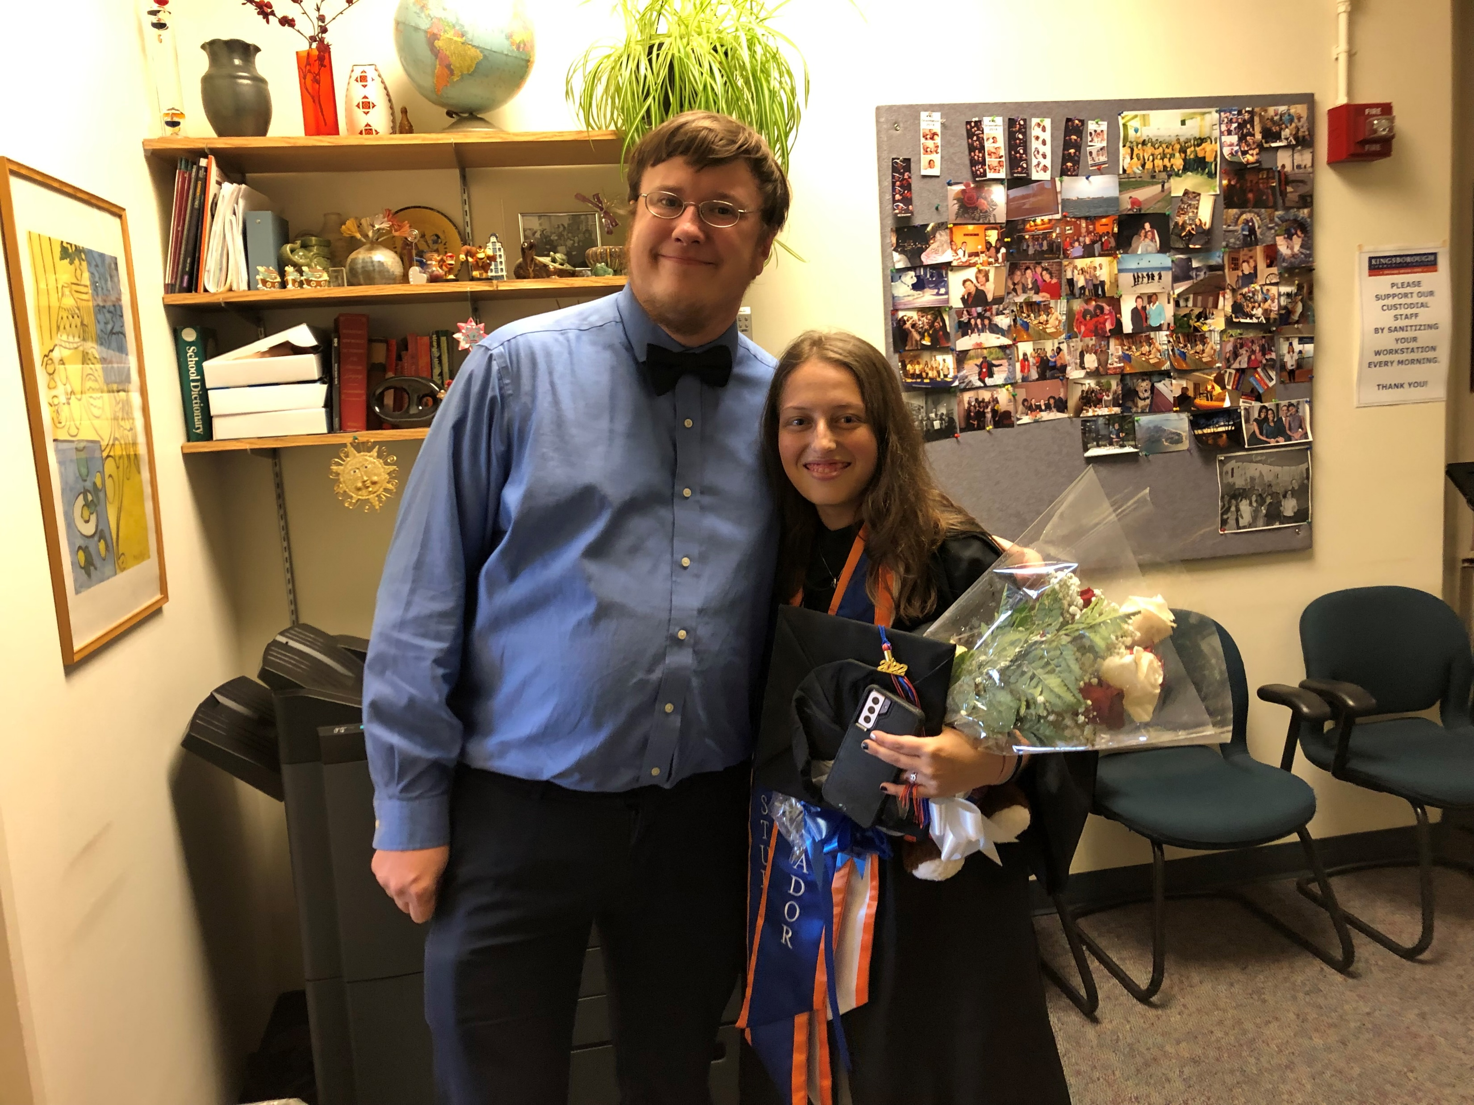

Slide 11
Using the Learning Community to Point Students in the Right Directions
  Scenario #1
  A student in your Learning Community is performing poorly in both your class and another class in the LC. While the student is always present and participates well in class, their essays and homework are either poor or not turned in. During a discussion in the other LC class, the student discloses they are working 2 jobs in addition to taking classes full time, and barely have time to sleep between school, work, and commuting. Halfway through the semester, the student disappears for a week, then when they return, they give you a note from a doctor asking you to excuse the absences due to the student’s recent hospitalization for exhaustion.
How can you and your LC Partners help this student?
  What resources can you refer them to?
  What else can you do to help the student be more successful?

Slide 12
How this situation turned out
This scenario was inspired by a real student, who was enrolled in a Learning Community involving Freshman English, Intro to Sociology, and Freshman Seminar.
The student came to see me after being released from the hospital seeking a way to make a change. She realized she couldn’t keep up the pace she’d been doing.
As I served as both her Freshman Seminar Instructor and her Academic Advisor, I was able to help advise her to withdraw from two classes. Using a unique policy at the college, we were able to put those classes in Winter, and she was able to retain her full-time status for financial aid.
The Sociology professor extended the deadline on a major project to allow her time to catch up.
During the time she had previously been in the courses she withdrew from, the English professor brought her to the Writing Center to help her work on making her essays stronger.
In the spring semester, the student spread her courses between Spring and Summer as I had advised, so she would have fewer courses per term.
The student graduated successfully!

Slide 13
Using the Learning Community to Point Students in the Right Directions
Scenario #2
  A student in your Learning Community is acting out in their Biology class. The student always seems to have difficulty controlling their impulses, particularly when they are frustrated. At one point, the student answered a minor question incorrectly, and when hearing they were wrong, flipped a book off the desk and left the room sobbing. After the student calmed down, they revealed to one of the professors that they are responsible for the care of their mentally ill mother and grandfather, and need to become a doctor in order to make enough money to support the family, so they cannot afford to do poorly in Biology.
How can you and your LC Partners help this student?
  What resources can you refer them to?
  What else can you do to help the student be more successful?

Slide 14
How this situation turned out
This scenario was inspired by a real student, who was enrolled in a Learning Community involving Anatomy & Physiology I and Freshman Seminar.
Following the conversation regarding his career goals, the A&P professor and I met with the director of the Counseling Center for tips on how we could better respond to this student.
Based on the advice we got, we began to work with him more one-on-one, providing encouragement, setting boundaries, and letting him know that he was valued.
During one such one-on one discussion, following a lesson in SD-10 on career exploration, the student realized that his goal to become a doctor wasn’t actually what HE wanted, but rather what others wanted for him. We encouraged him to spend more time on campus, rather than at home, to give him space to discover his own interests and goals.
He joined clubs and became very active in the campus Urban Farm. He changed his major to Psychology, excelled in those classes, became a TA for one of the Psychology professors, and graduated with a 3.0 GPA.
He transferred on to a Bachelors program, and while working on his B.A., got a job at KBCC working as an advocate for students with disabilities. He is now a valued colleague!

