Slide 1
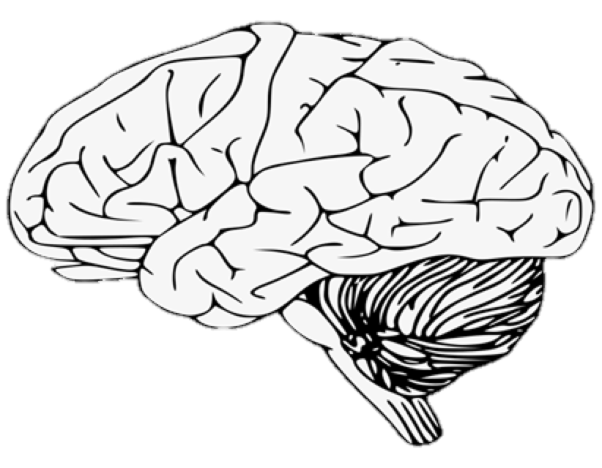
Mind the Gap
Bridging Siloed Learning Communities through Supplementary Interdisciplinary Interactions
Susie Banks, Christopher Brandon, and Melanie Law
Florida Southern College

Slide 2
Goals for today’s workshop:
Share our story
Collaborative approaches to improve student experience and reduce faculty workload
Feedback

Slide 3
Sharing Our Collaborative Experience
Learning Community Models
Florida Southern College Snapshot
Psychology Learning Community Model
Biology Learning Community Model
"Minding the Gap" Merging the Silos
Gattaca Discussion Demo
Feedback

Slide 4
“Learning communities are a variety of curricular approaches that intentionally link or cluster two or more courses, often around an interdisciplinary theme or problem, and enroll a common cohort of students.”
(Smith, MacGregor, Matthews, & Gabelnick, 2004, p. 67)

Slide 5
Popular Learning Community Models
Linked or Paired Courses
Links a cohort of 30 or fewer students together in 2 courses
Usually offered using block-scheduling
Clusters link more than 2 courses
Freshman or Student
Interest Groups
More common with large universities
Creates subsections of cohorts from larger course enrollments
Peer advisor/mentor
Residence-based or Living Learning Communities
Enrolled in courses together and live together
Team Taught or
Coordinated Studies Programs
Enrolls larger cohorts of students into 2 to 5 shared courses across disciplines.
Team-taught by 2 or more faculty members
(Gabelnick, MacGregor, Mathews, & Smith, 1990; Jones, Laufgraben, & Morris, 2006; Levine-Laufgraben, 2005)

Slide 6
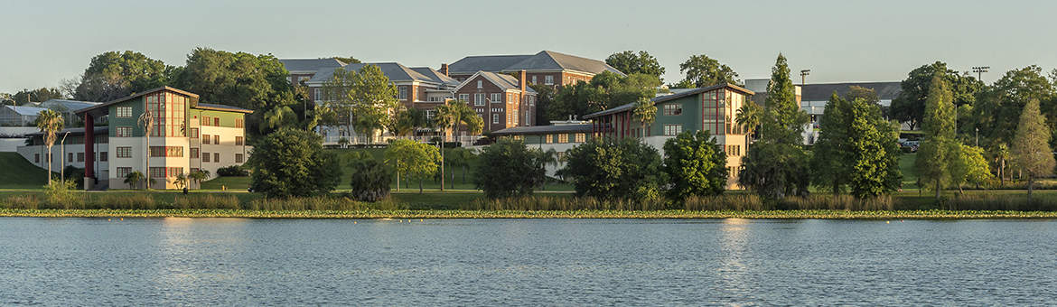
Florida Southern College
Who we are:
2633 undergrads
Private undergraduate teaching college
149 faculty members
70+ majors
Demographics
Curriculum & instruction:
Experiential learning
Internships
"Junior Journeys"
Advising
Research
Passport Program - 5 Categories
Notes:
Categories of Passport programs

Slide 7
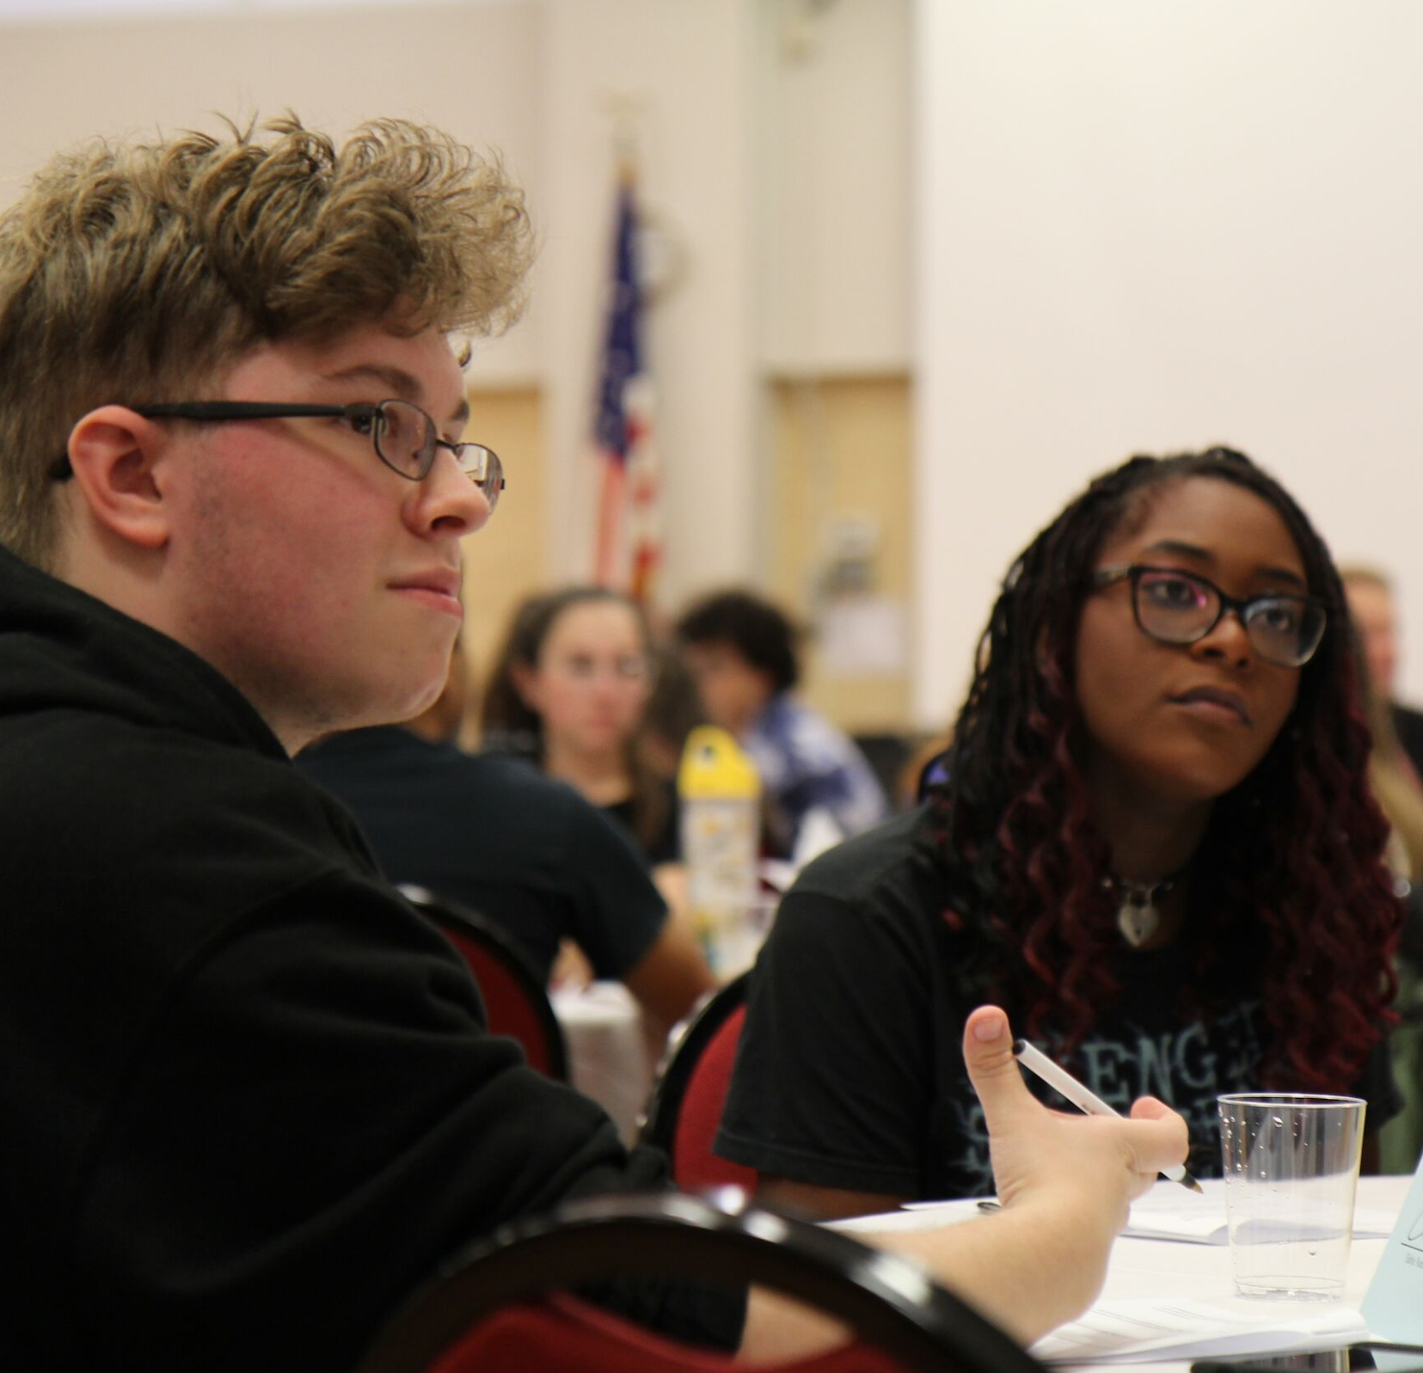
FSC Learning Community Snapshot
~720 first year students
All 1st year students placed into LC
LC model varies across campus
Departments vary in student number
  ~100s
  ~10s

Slide 8
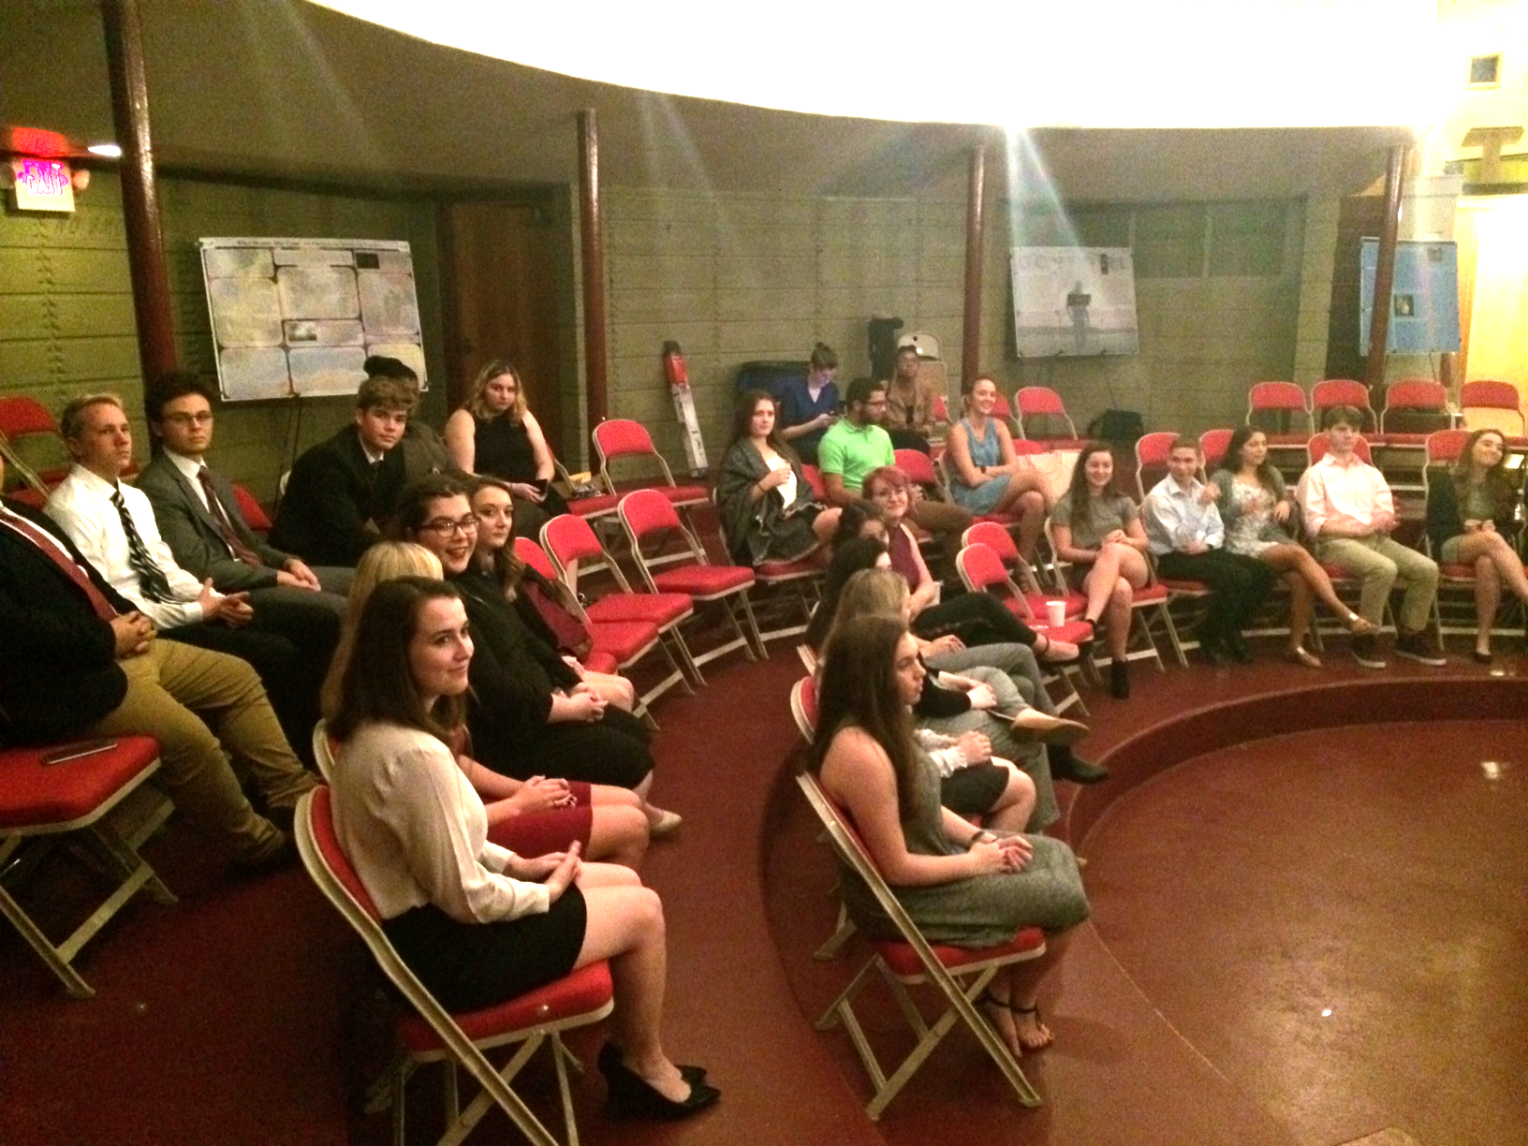
Psychology Learning Communities
Inaugural Learning Community
2 Learning communities (15-20 students each)
  Paired courses
    Psych of the Natural World & Psych of the Social World
  4 different faculty
  3 - 4 meetings per semester outside of class time (Psi Pie Nights)

Slide 9
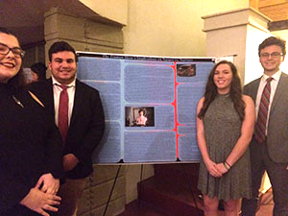
End-of-Semester Culminating Event
Student Poster Conference
  Analysis of a film
  Nature vs. Nurture theme combines content from both courses
  Business attire
  Other faculty and students are invited
Notes:
Link to FSC News: https://www.flsouthern.edu/news/floso-voices/2019/poster-presentation-red-carpet.aspx

Slide 10
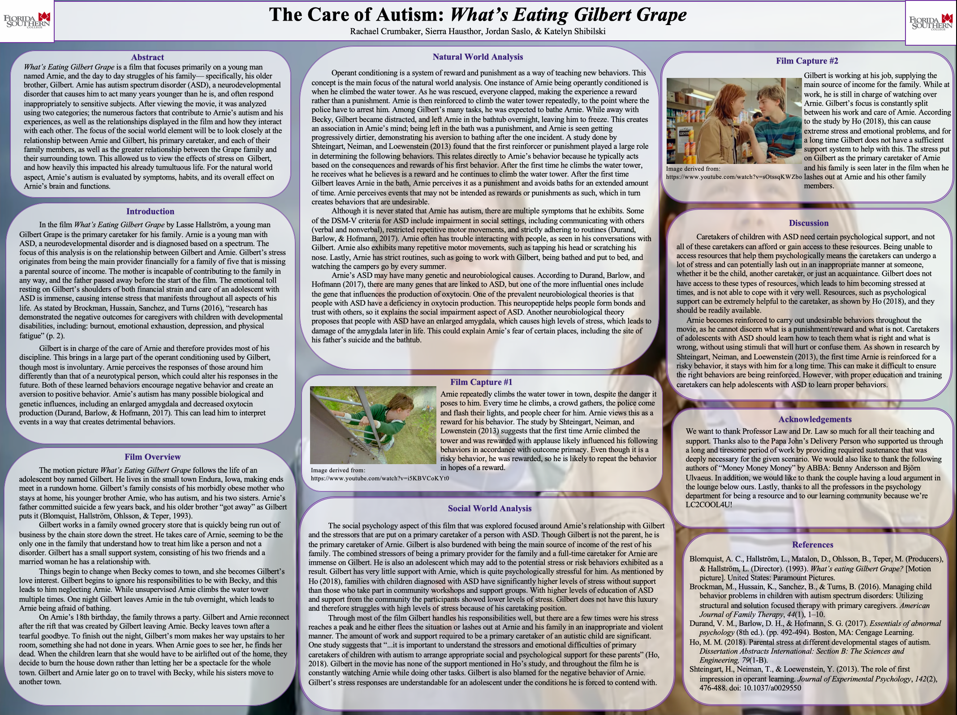

Slide 11
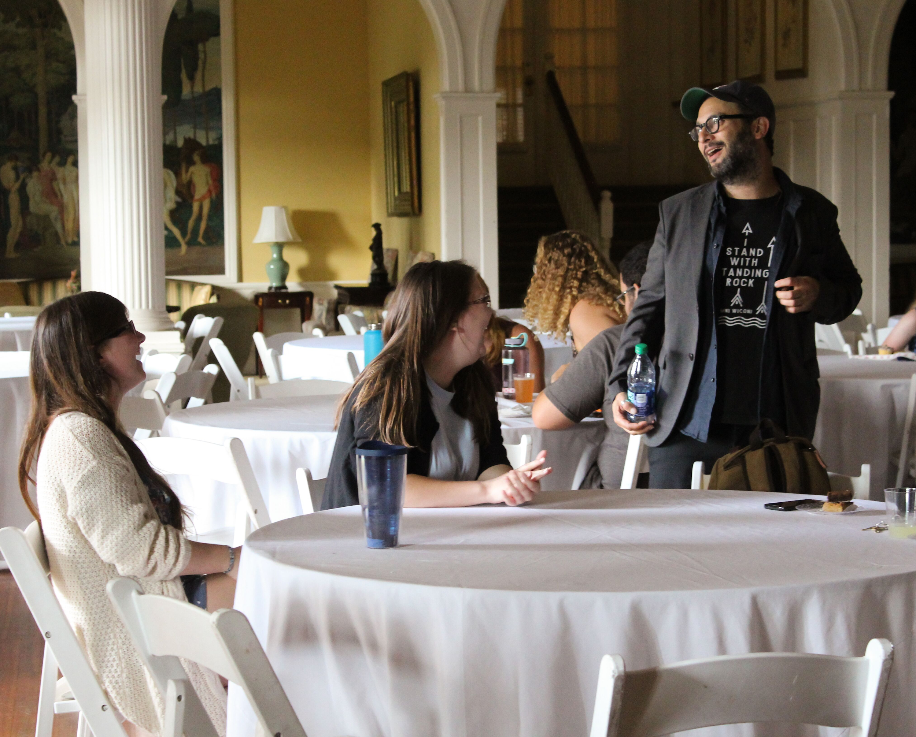
Biology Learning Communities
Established Fall 2018
120-150 students divided into 9 sections
Introductory biology lecture and laboratory course paired with a seminar course
Multiple majors within Biology

Slide 12
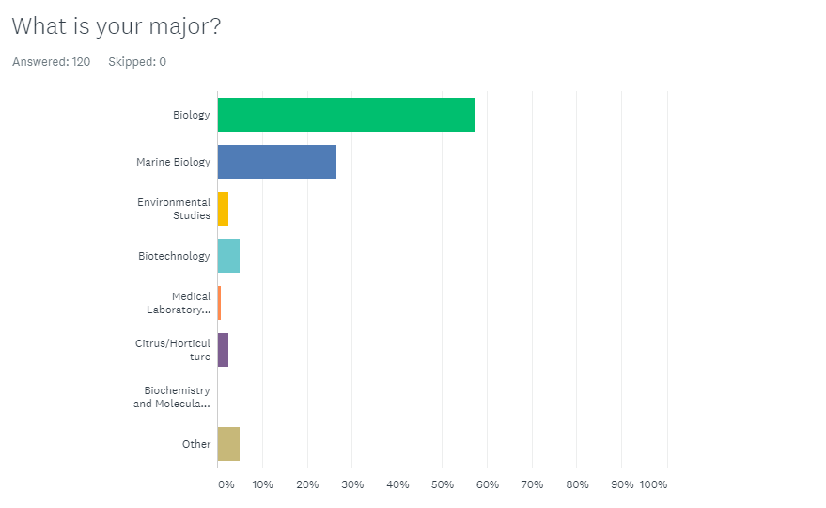
Our Students
Survey Monkey,
N = 120

Slide 13
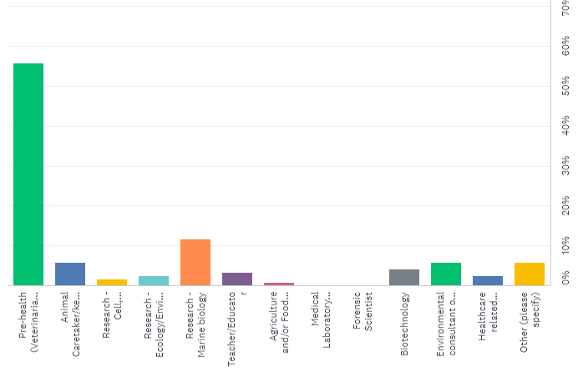
Students Aspirations are Diverse
Research
Industry

Slide 14
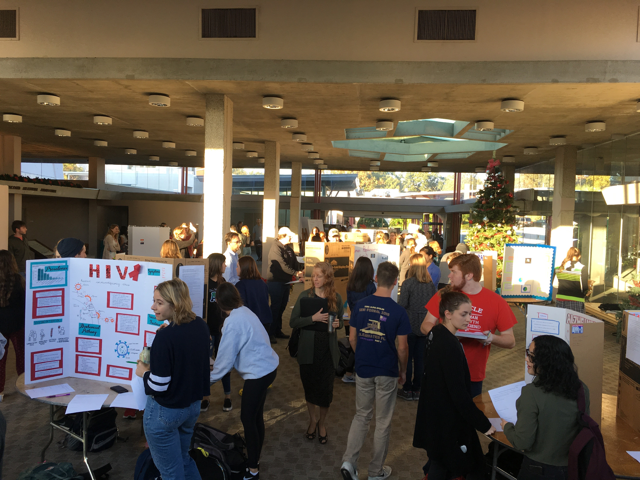
First Year Experience for the First Year Experience
Central themes: climate change + antibiotic resistance
Seminar + lab class
  Informal seminar
    Lab introductions
    Building basic skills
    Building community
  Lab class
    "Student" sourced independent research project

Slide 15

Our big event

Slide 16

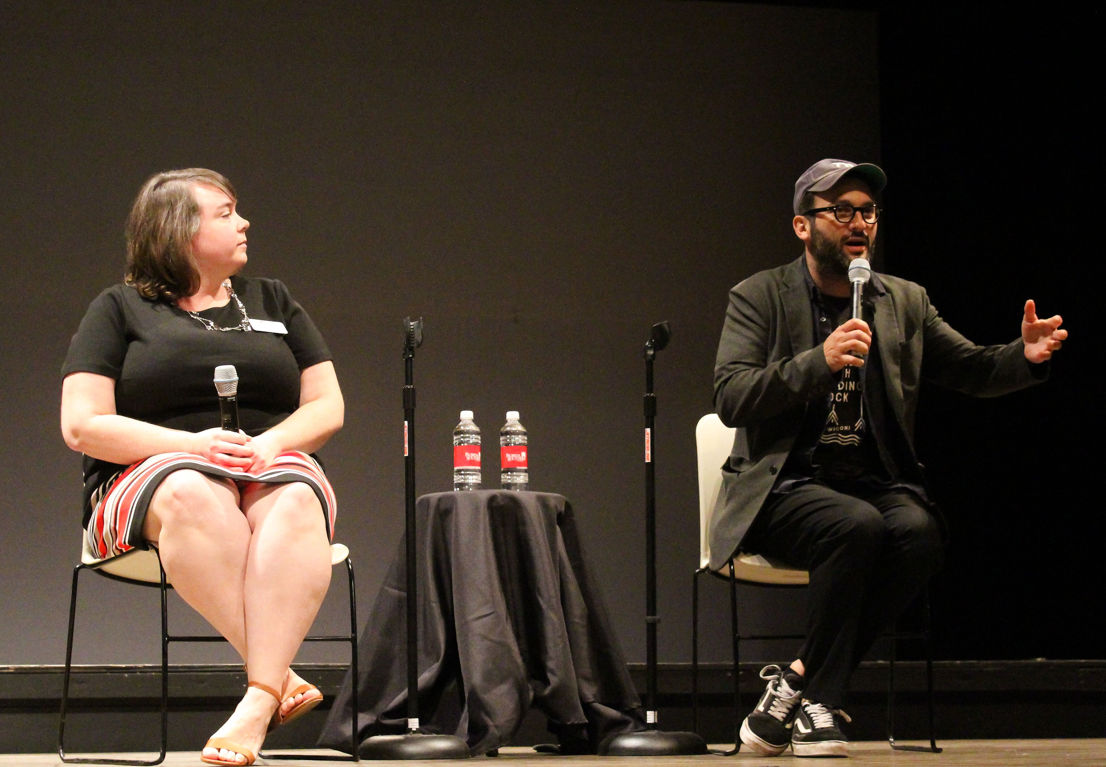
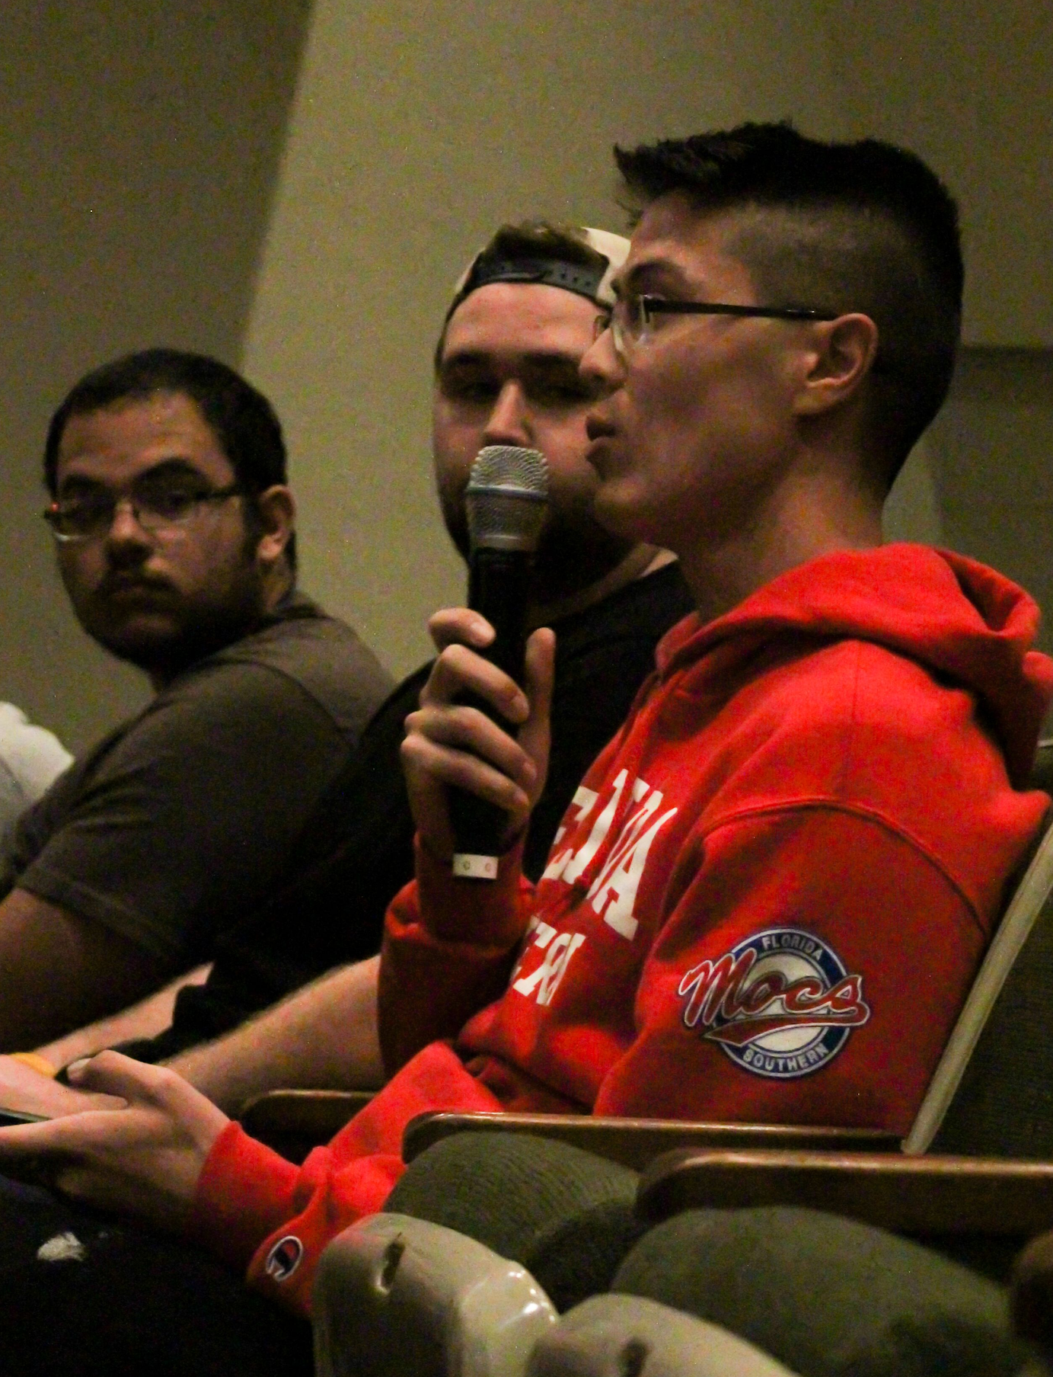
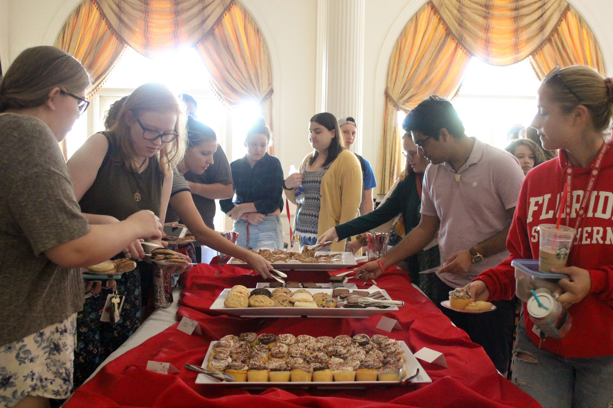
Our Big Event Fall 2018
Screening
Q&A w/ director
Reception w/ director
Resource sharing

Slide 17
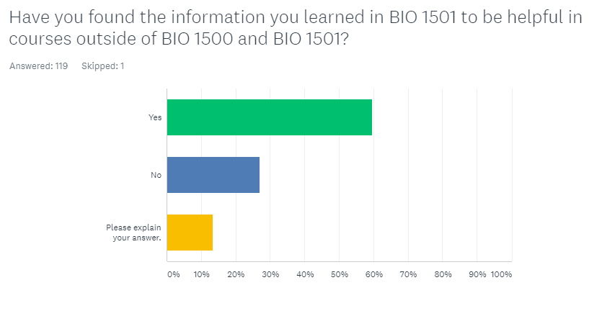
What We Learned
This is yes or no, with an explanation

Slide 18
What We Learned: Student Voices
"The study techniques are very useful for learning any subject. The teaching to learn presentation also helped me understand how teaching can improve my own knowledge significantly."
***
"I found the exercises such as reading primary literature and forming an annotated bibliography will greatly help me for other classes, and I am also glad that I have been able to get to know all the people in my BIO 1501 class"
***
"Leading how to use portal or how to complete required things helped but I feel like the presentations and homework did not help that much"

Slide 19
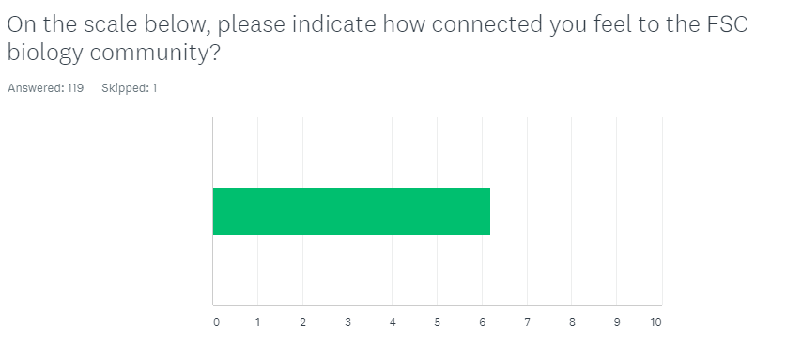
What We Learned: Community Connection

Slide 20
Feedback and Modifications for 2nd Year
Central Theme: Genetics and environment
Peer Mentor program
More extracurricular activities
Time change
Lunches
Shared information sessions
  Library resources
  Health Professions and STEM Career Center Director

Slide 21
What our students said about the prospect of peer mentors
If you were a peer mentor, what programs, events, or activities would you include to support the learning community students?
"Maybe make a groupme with all members of the community so if they had questions they could ask the whole group if any of them knew the answer or even maybe plan to study as a group for exams"
"I would include study sessions when they are close to exams. If we are forced to study for a grade, it would make us take the time. I also would recommend the S cubes sessions because I found those to be really helpful"

Slide 22
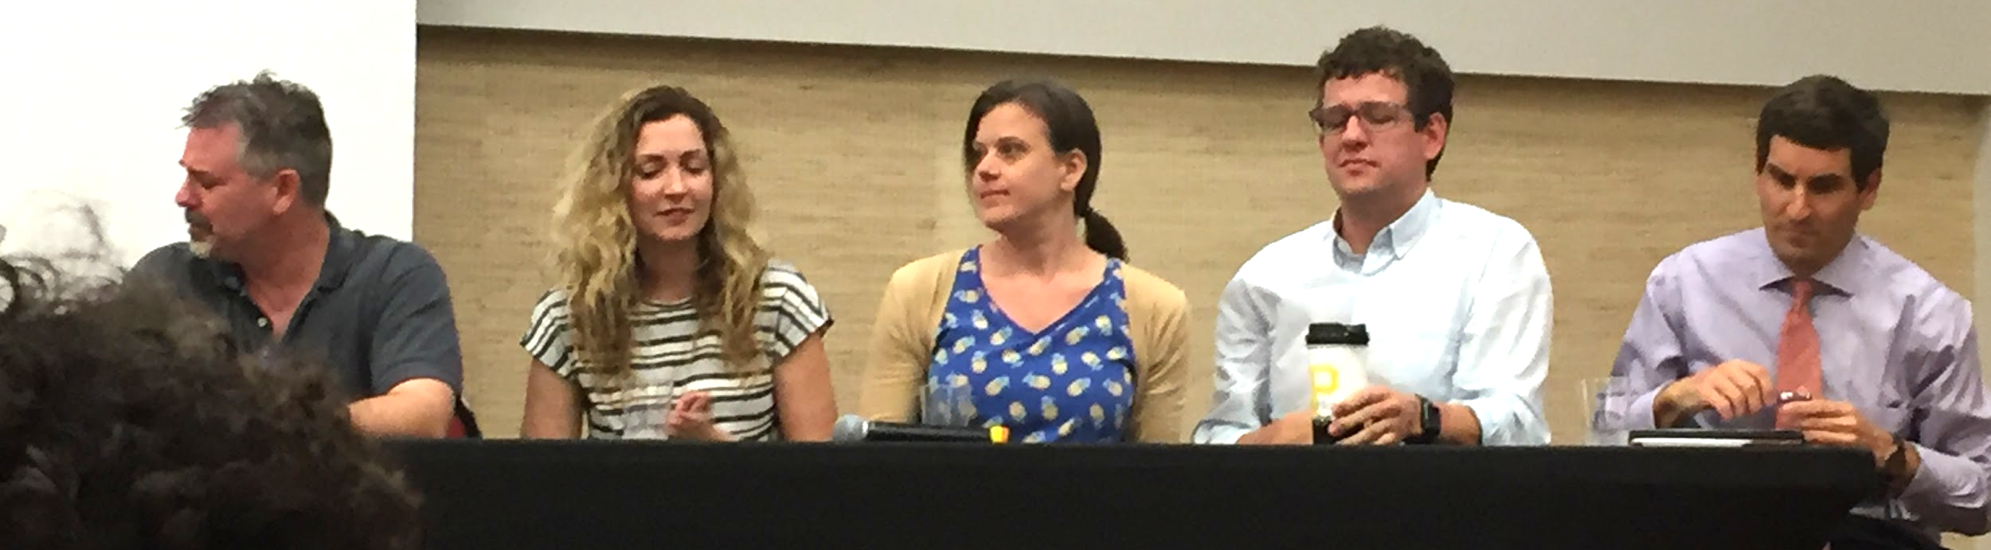
Merging the Silos
Biology & Psychology

Slide 23
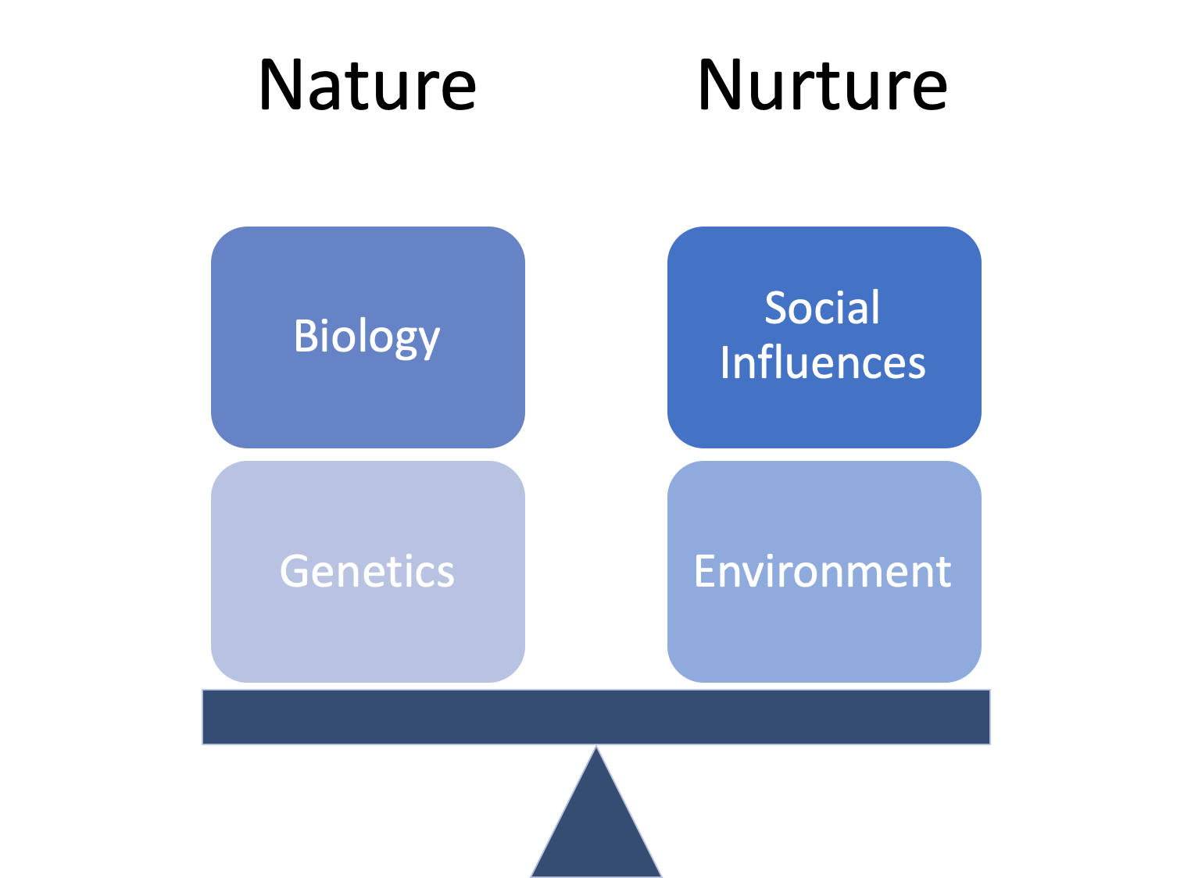
What Do You Think Influences You More?
www.menti.com
Code: 72 89 08
Notes:
Mentimeter

Slide 24
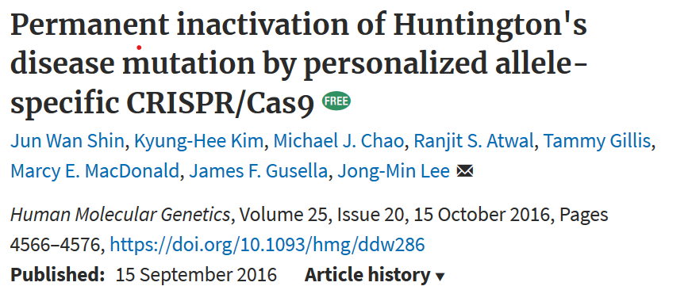
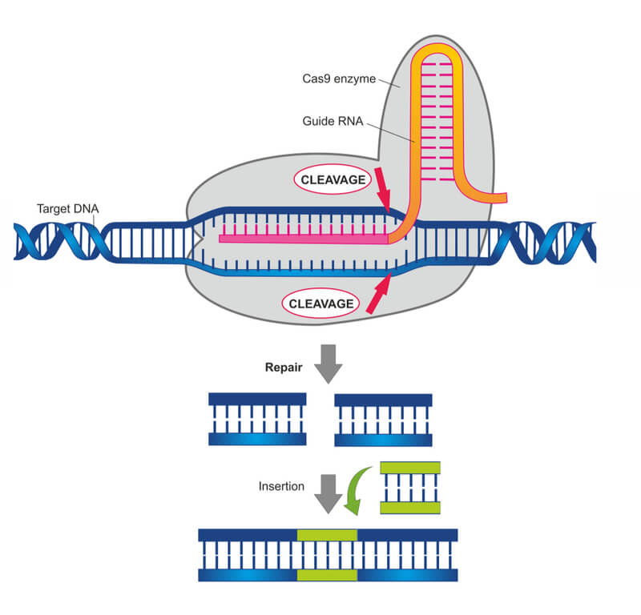
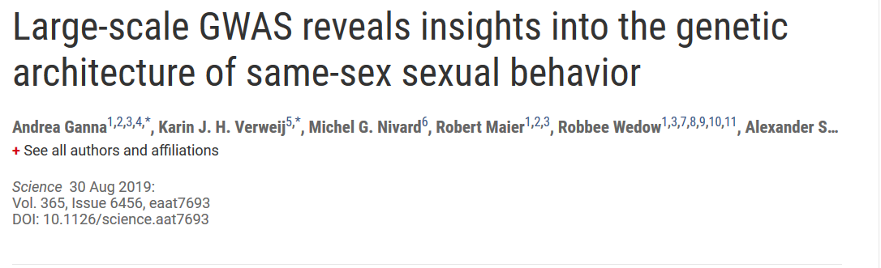
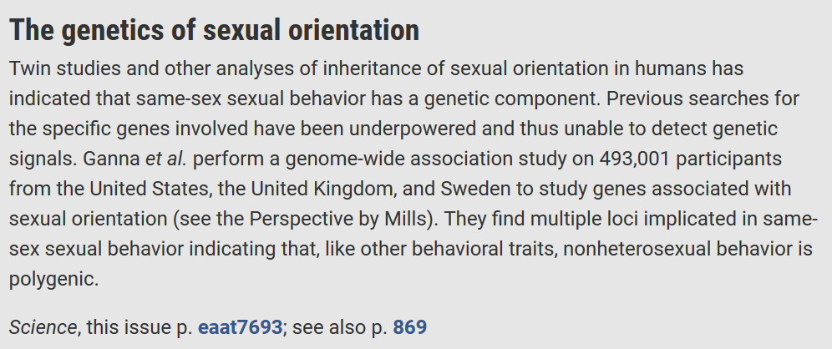
CRISPR-Cas9

Slide 25
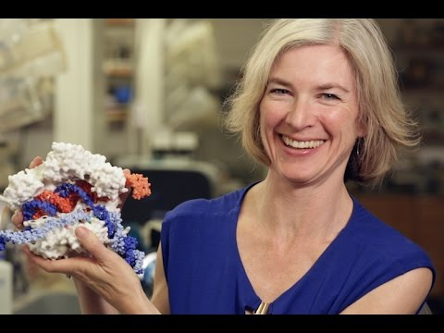

Slide 26
Big Event Fall 2019
250 students attended the film screening
150 students attended the discussion and 23 faculty & peer mentors

Slide 27

Notes:
Click to play
Official Trailer: https://youtu.be/DO_x-po_Nsc

Slide 28
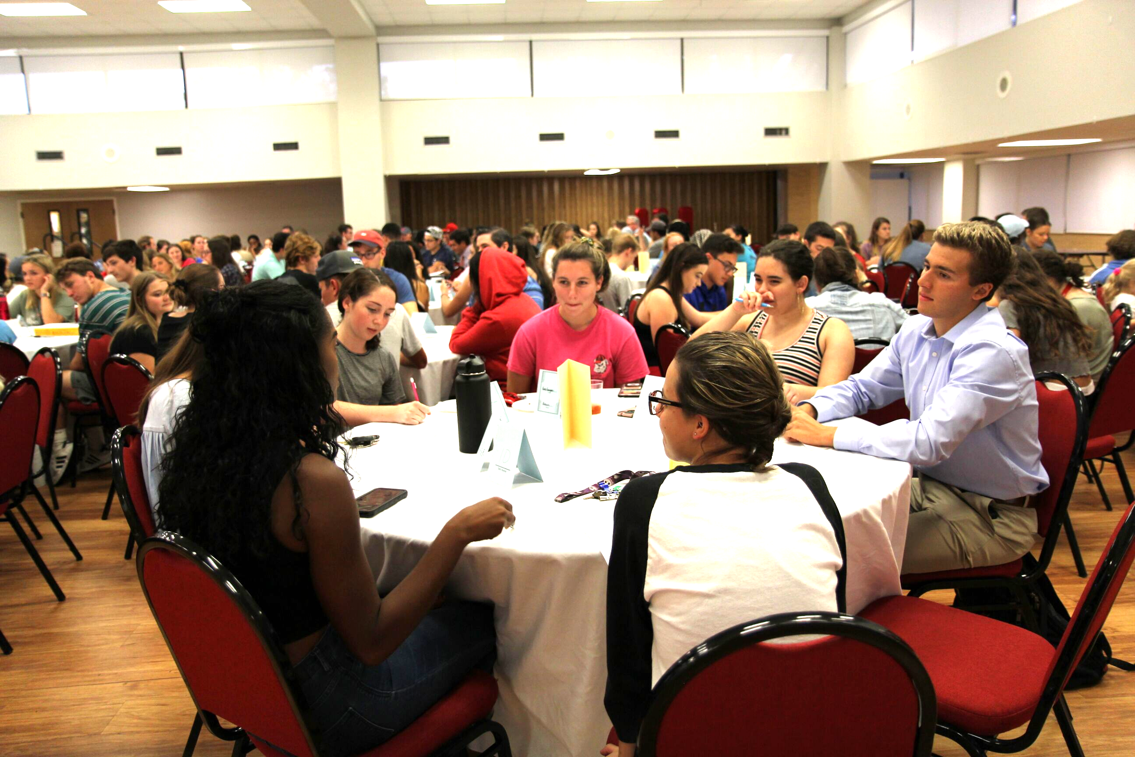
Event Planning Breakdown - Shared Resources
Student Life (Mike Crawford)
  Film Screening Rights
  Passport Credit
  Refreshments
  Room Reservation & Setup
  Tech Support
Biology & Psychology
  Advertising
  Recruitment
  Worksheets
  Table place cards
  Panel Discussants
Notes:
Religion, Biology, Psychology, Computer Science, Criminology

Slide 29
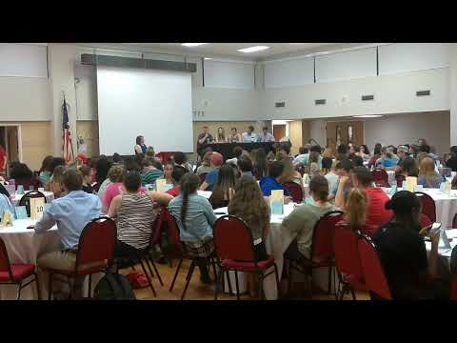

Slide 30
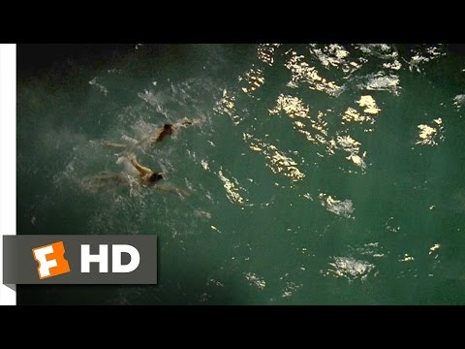

Slide 31
Gattaca Discussion Demo
Find your leader and join your groups
  Leaders: Read the “Gattaca Fearless Leaders” Guide
  All Group Members: Read the discussion questions worksheet
Follow the “Fearless Leader” instructions

Slide 32
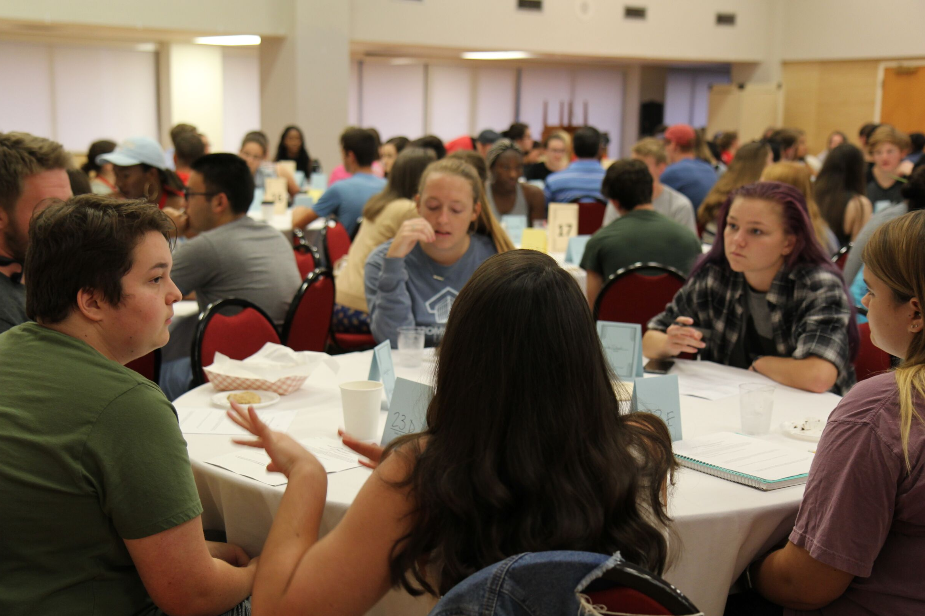
What Did We Learn?
Future Events?

Slide 33

Feedback- suggestions

Slide 34
Brainstorm
Other Disciplines
Changes
Events
Notes:
If you already have interdisciplinary collaboration in your LC, are there any changes you would make?
Different or increased events?
Inclusion of other disciplines?

Slide 35
References
Jones, P. R., Laufgraben, J. L., & Morris, N. (2006). Developing an empirically based typology of attitudes of entering students toward participation in learning communities. Assessment and Evaluation in Higher Education, 31(3), 249–265. https://doi.org/10.1080/02602930500352766
Levine-Laufgraben, J. (2005). Building learning communities for first-year students. In Robert S. Feldman (Ed.), Improving the first year of college: Research and practice (pp. 195–218). Mahwah, NJ: Lawrence Erlbaum Associates.
Smith, B. L., MacGregor, J., Matthews, R. S., & Gabelnick, F. (2004). Learning communities: Reforming undergraduate education. San Francisco, CA: Jossey-Bass.
Presentation template by SlidesCarnival

Slide 36
Thank you!
Biology
Susie Banks sbanks@flsouthern.deu
Christopher Brandon cbrandon@flsouthern.edu
Psychology
Melanie Law mlaw@flsouthern.edu

