Slide 1
LC101: Developing and Implementing Learning Communities
Brad Hollingshead, Ph.D.
Provost
Dahl & Lottie Pryor Endowed Chair in English
Florida Southern College
bhollingshead@flsouthern.edu
Terry Novak, Ph.D.
Professor of English
Johnson & Wales University
terry.novak@jwu.edu
Atlantic Center for Learning Communities Retreat
October 2019

Slide 2
Objectives
Identify reasons for Learning Community (LC) development
Develop goals, objectives, and timeline for LC implementation
Identify colleagues to be on LC development team
Learn about resources for LC development and implementation

Slide 3

Why Learning Communities?
“A curriculum experience that requires the integration of ideas, courses, and disciplines enhances critical thinking over the more typical curriculum.”
  Pascarella & Terenzini, 1991, p. 144.

Slide 4
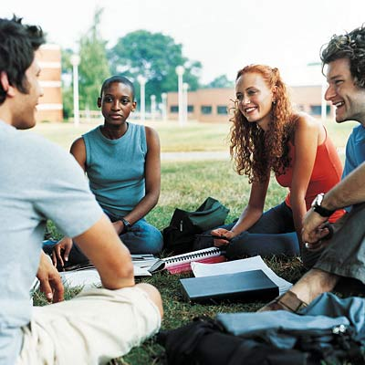
Key Aspects of LCs:
Link or cluster courses and faculty around an interdisciplinary theme
Enroll a common cohort of students
Restructure students’ time and learning experiences
Foster explicit intellectual connections between:
  Students and students
  Students and faculty
  Faculty and faculty

Slide 5
Collaborative learning assumptions
Learning is an active, constructive process
Learning depends on rich contexts
Learners are diverse
Learning is inherently social
Smith, B.L. and MacGregor, J. (1992). What is Collaborative Learning? In Collaborative Learning: A Sourcebook for Higher Education. Goodsell, A,. Maher, M., & Tinto, V., Eds. University Park, PA: National Center on Postsecondary Teaching, Learning, and Assessment.

Slide 6
LCs incorporate “Principles for good practice in education”
Student-faculty contact
Active learning
Prompt feedback
Time on task
High expectations
Respect for diverse learning styles
Cooperation among students
  Chickering & Gamson, 1987, AAHE

Slide 7
Factors that enhance student learning
Increased amounts and quality of interaction (Astin)
  Student-student , student-faculty
  Study outside of class
High levels of involvement and engagement (Kuh, NSSE)
  Academic challenge
  Active learning
  Student-faculty interaction
  Supportive campus environment
  Enriching educational experiences
Astin, A. (1993). What matters in college? Four critical years revisited. San Francisco: Jossey-Bass.
Kuh, G. D. et al., (2005). Student success in college: Creating conditions that matter. San Francisco: Jossey-Bass.

Slide 8
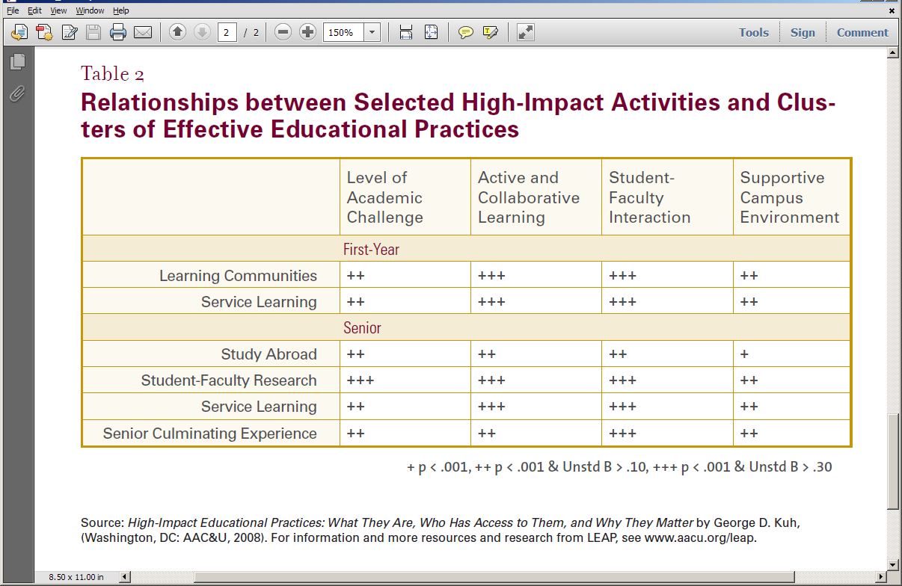

Slide 9
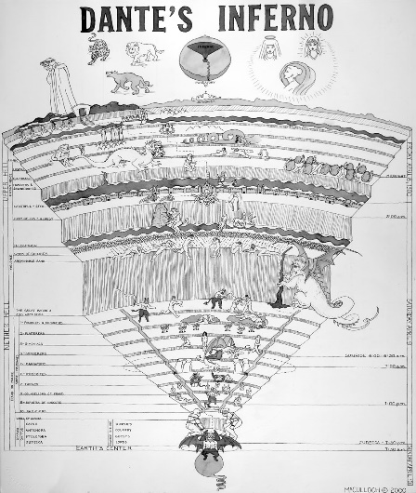
Aims of Learning Communities
Increase curricular coherence
Promote deep learning
Connect skill and content areas
Build community
Revitalize faculty
Revitalize the institution
Promote diversity
Enhance student engagement
Enhance student achievement
Increase retention
“Hell is a place where nothing connects with nothing”
Dante
Notes:
Across these models learning communities aim to: READ List

Slide 10
Identify reasons for LC development
Take a minute to write your goals for LC development

Slide 11

Possible reasons for LC development
Improve the first-year experience of students
Provide an interdisciplinary focus
Incorporate experiential learning or service learning
Integrate the in-class and out-of-class experiences of students
Meet General Education curriculum requirements
Meet major requirements
Other?

Slide 12
Key Findings from a Survey of 400 Executives
Hart Research Associates, 2015

Slide 13
Examples of LC goals and outcomes
St. Louis University
  http://www.slu.edu/housing/living/learn/
  Holyoke Community College
  https://www.hcc.edu/courses-and-programs/integrative-learning/learning-communities
  Bunker Hill Community College
  http://www.bhcc.mass.edu/learning-communities/
  The Learning Community Seminar is a 3-credit course that will help you make friends, connect with faculty, and learn what it takes to succeed in college.
    BHCC Learning Community Clusters enable you to take two or more courses together and learn and study with the same group of students. . . . You will be more likely to stay in school, maintain a higher GPA, and achieve your goals.

Slide 14
Examples of goals and outcomes, cont.
Louisiana State University
  The goals of the Learning Communities Program are to enhance the quality of student learning and to provide faculty with opportunities to collaborate in teaching across the disciplines. Specifically, the objectives of the program are as follows:
    1) to promote a deeper understanding of subject matter by examining it from the perspectives of different disciplines;
    2) to increase faculty-student and student-student interaction;
    3) to increase student responsibility for learning and for helping other students to learn,
    4) to create active learning environments and
    5) to improve retention rates among students.

Slide 15
Make LC goals “SMART”
Specific
  Who is your audience? Which departments and faculty?
Measurable
  Specify outcomes that can be seen, demonstrated, described (essential for gauging success)
Attainable and Realistic
  Be ambitious and rational; stretch yourselves but don’t snap
Timely
  Set intermediate timelines to help stay on track and give direction to others

Slide 16
Goals, cont.
Take a few more minutes to add to your goals
  Be specific
  What measures?
  Reality check
    Are they ambitious and reachable?
    In what timeframe?
Share with the group

Slide 17

What are your resources?
Possible resources:
  People – faculty, administrators, staff, students
  Space/facilities
  Money
  Time
  Programs
  Other

Slide 18


Obstacles and Allies
What obstacles do you anticipate?
Who are your allies?

Slide 19

Gather your LC development team
Look at list of resources, obstacles, and allies to see who should be included. Work with the willing.
Suggested team/Advisory Board members:
  Faculty
  Academic administrator (“champion”)
  Librarian/Information Literacy
  Academic advisor
  Registrar
  Student affairs administrator
  Student (if peer mentors/educators are involved)

Slide 20
Action plan
What are some of the action steps to take when you return to campus in . . .
  One week?
  One month?
  Three months?
  Six months?

Slide 21
Faculty recruitment ideas
Emphasize opportunities:
  work with a colleague(s) in a different department or discipline
  work with a different population of students
  be innovative – new teaching methods, different topics, different texts and assignments/assessments, new scholarly opportunities
Possible perks – release time, stipend, equipment, visibility
TALK to people
Get department chairs on board
Recruit from across campus, seek diversity and wide representation

Slide 22
Market LCs to students, parents, and -
Admissions officers
Academic advisors
Student affairs colleagues - orientation, residence life
Communications colleagues - website, brochures, news, FaceBook, Twitter, etc.
Other faculty and admins. – don’t keep it a secret

Slide 23
Sample LC web pages
Participating institutions of the Atlantic Center for Learning Communities (ACLC):
  https://atlanticcenterforlearningcommunities.org/about/
The University of Washington
  http://fyp.washington.edu/figs/
Delta College
  https://www.deltacollege.edu/academics/academic-support-programs-and-communities/learning-communities/about-learning-communities
New Century College at George Mason University
  https://www2.gmu.edu/academics/new-century-college

Slide 24
LC resources - online
The Washington Center at Evergreen State College
  http://wacenter.evergreen.edu/?
The Journal of Learning Community Research and Practice
  http://washingtoncenter.evergreen.edu/lcrpjournal/
Research on LC development and effectiveness
  http://www.mdrc.org/project/learning-communities-demonstration#featured_content
LC bibliography
  https://atlanticcenterforlearningcommunities.org/contact/
Learning Communities listserv
  http://www.freelists.org/list/learningcommunitiesassociation

