Slide 1

HIP, HIP, Hooray!
Incorporating more High Impact Practices into Learning Communities
Cheryl Scott, Professor of English
Amy Wilson, Assistant Professor of English

Slide 2
High-Impact Practices
Teaching and learning practices have been shown to be beneficial for college students from many backgrounds, especially historically underserved students, who often do not have equitable access to high-impact learning.
Learning Communities
Collaborative Assignments and Projects
Diversity/Global Learning
Undergraduate Research
Service Learning, Community-Based Learning
Writing-Intensive Courses
First-Year Experiences (Academic Development courses)
Common Intellectual Experiences
Internships
ePortfolios
Capstone Courses and Projects

Slide 3
What is a Learning Community?
An integrated approach to teaching and learning.
In a learning community, two or more classes are “paired,” and a group of students enrolls in both of the paired courses.
Faculty work together to integrate course content and materials in order to emphasize the connections between the subject areas.
Because students take the same classes together, strong bonds form as they study together, support each other, and learn from one another.
A High Impact Practice (HIP) that increases student engagement, student success, and student retention (George Kuh, AAC&U, 2008).

Slide 4
Broad Purposes
Offer students a more integrated learning experience
  Greater curricular coherence and
  Increased collaboration of students and faculty
More supportive learning environment
  Peer bonding
  Student faculty bonding
  Peer mentoring
Enrich learning experiences
  Integrative assignments
  Active learning activities

Slide 5
Learning Community Objectives:
Acquire deeper understanding of both subjects
Understand relationships between the different subjects
Think critically and analytically
Deal with complex problems that have multiple perspectives
Be personally accountable for learning
Feel supported by teachers and peers
Work effectively with others
Learn effectively on one’s own

Slide 6
What is Integrative Learning?
“Capacity to integrate knowledge and modes of thinking from two or more disciplines in order to produce a cognitive advancement - to explain phenomena, fashion products, solve problems, in ways that would have been unviable through a single disciplinary means.” (Veronica Boix-Mansilla).
Builds the capacity to use knowledge rather than just accumulate knowledge.

Slide 7
Strategies for Integration
Design integrative assignments that meet course objectives from both courses.
Revise syllabi to reflect connections between the courses and course content.
Use fiction and nonfiction readings with common themes.
Create common themes (ex. “Cultural & Global Issues.”)
Visit each others’ classes periodically to observe or participate in class activities.
Communicate weekly with each other to plan activities and discuss student behaviors, progress.
Meet with each student for midterm conferences as a team.
Participate in research efforts.

Slide 8
Benefits: Students
CCBC’s LEARNING COMMUNITIES are HIP!
Learning communities can have a ‘high-impact’ on student outcomes through the ‘integration of learning across courses and disciplines (LEAP).
Offers an integrated learning experience:
  Assignments
  Syllabi
  Policies
Helps understanding of relationship between different subjects and disciplines
Provides opportunities to think critically and analytically.
Encourages personal accountability for learning.
Provides enriched and supportive learning experience:
  Work collaboratively with others
  Forms close bonds with faculty and peers

Slide 9
Benefits: Faculty
Creates Partnerships.
Develops self-awareness of one’s own teaching.
Places more attention on delivery systems.
Uses more collaborative learning techniques.
Develops more compassion for students.
Encourages faculty to be more flexible.
Encourages students to take more responsibility for learning.
Offers opportunity for professional development.
Stipends for extra responsibility and time spent on professional development.

Slide 10
Combining HIPs:
Team Teaching
Integrated Material & Assignments
Service Learning
Portfolio Grading
ARSC 121: American Pluralism, the Search for Justice
ENGL 102: College Composition II, Honors

Slide 11
Team Teaching
  one syllabus & schedule
  team teaching through shared instruction for both courses
  all assignments integrated, including feedback from both instructors
  portfolio grading

Slide 12
WEEK SEVEN
TUESDAY March 17
11:10 PART III: “Complicating Questions of Identity: Race, Ethnicity, and Immigration” (211- 214); “A Nation of Non and All of the Above” (215-216); “Impossible Subjects: Illegal Aliens and the Making of America” (224-234); “For Many Latinos, Racial Identity is More Culture than Color” (238-241); “The Myth of the Model Minority” (248-254).
12:45 The Bluest Eye
THURSDAY March 19
11:10 PART VI: “Many Voices, Many Lives: Issues of Race, Class, and Gender and Sexuality in Everyday Life” (407-409); “Crossing the Border Without losing Your Past” (428-429); “The Event of Becoming” (430-434); “This Person Doesn’t Sound White” (435-438); “Pigskin, Patriarchy, and Pain” (448-451); “Against ‘Bullying’ or On Loving Queer Kids” (465-467).
12:45 The Bluest Eye

Slide 13
Integrated Materials
Texts:
  Race, Class, and Gender in the United States, 9th Ed. Paula Rothenberg.
  The Bluest Eye. Toni Morrison.
  Nickel and Dimed: On (Not) Getting By in America. Barbara Ehrenreich.
Films/Videos:
  Ethnic Notions
  Inequality for All
  Miss Representation

Slide 14
Integrated Assignments
All Assignments shared
  Essays/Papers (graded by both instructors)
  BB Discussion Forum based on Readings
  Service Learning Project:
                Site Suggestions
                Requirements for Service Learning
                Timeline
                Reflection Essay
Notes:
Cheryl

Slide 15
Service Learning
Incorporates community work into the curriculum
Gives students real-world learning experiences that enhance their academic learning while providing a tangible benefit for the community

Slide 16
Portfolio Grading
Papers/ Portfolio Grading policy:
We will use portfolio grading in this course. Although the professors will comment extensively on each of your submitted assignments, we will not assign formal grades to individual assignments during the semester. Instead, you will have the opportunity to revise and refine your written work and then resubmit it in a final portfolio.
The final portfolio must include the originally submitted paper with professors’ comments along with the revised paper. *Papers not submitted during the semester may not be submitted in the portfolio.
The portfolio should also include a short cover essay in which you reflect on your writing over the course of the semester.
emphasizes feedback and revision
demonstrates skill development
highlights themes
promotes reflection

Slide 17
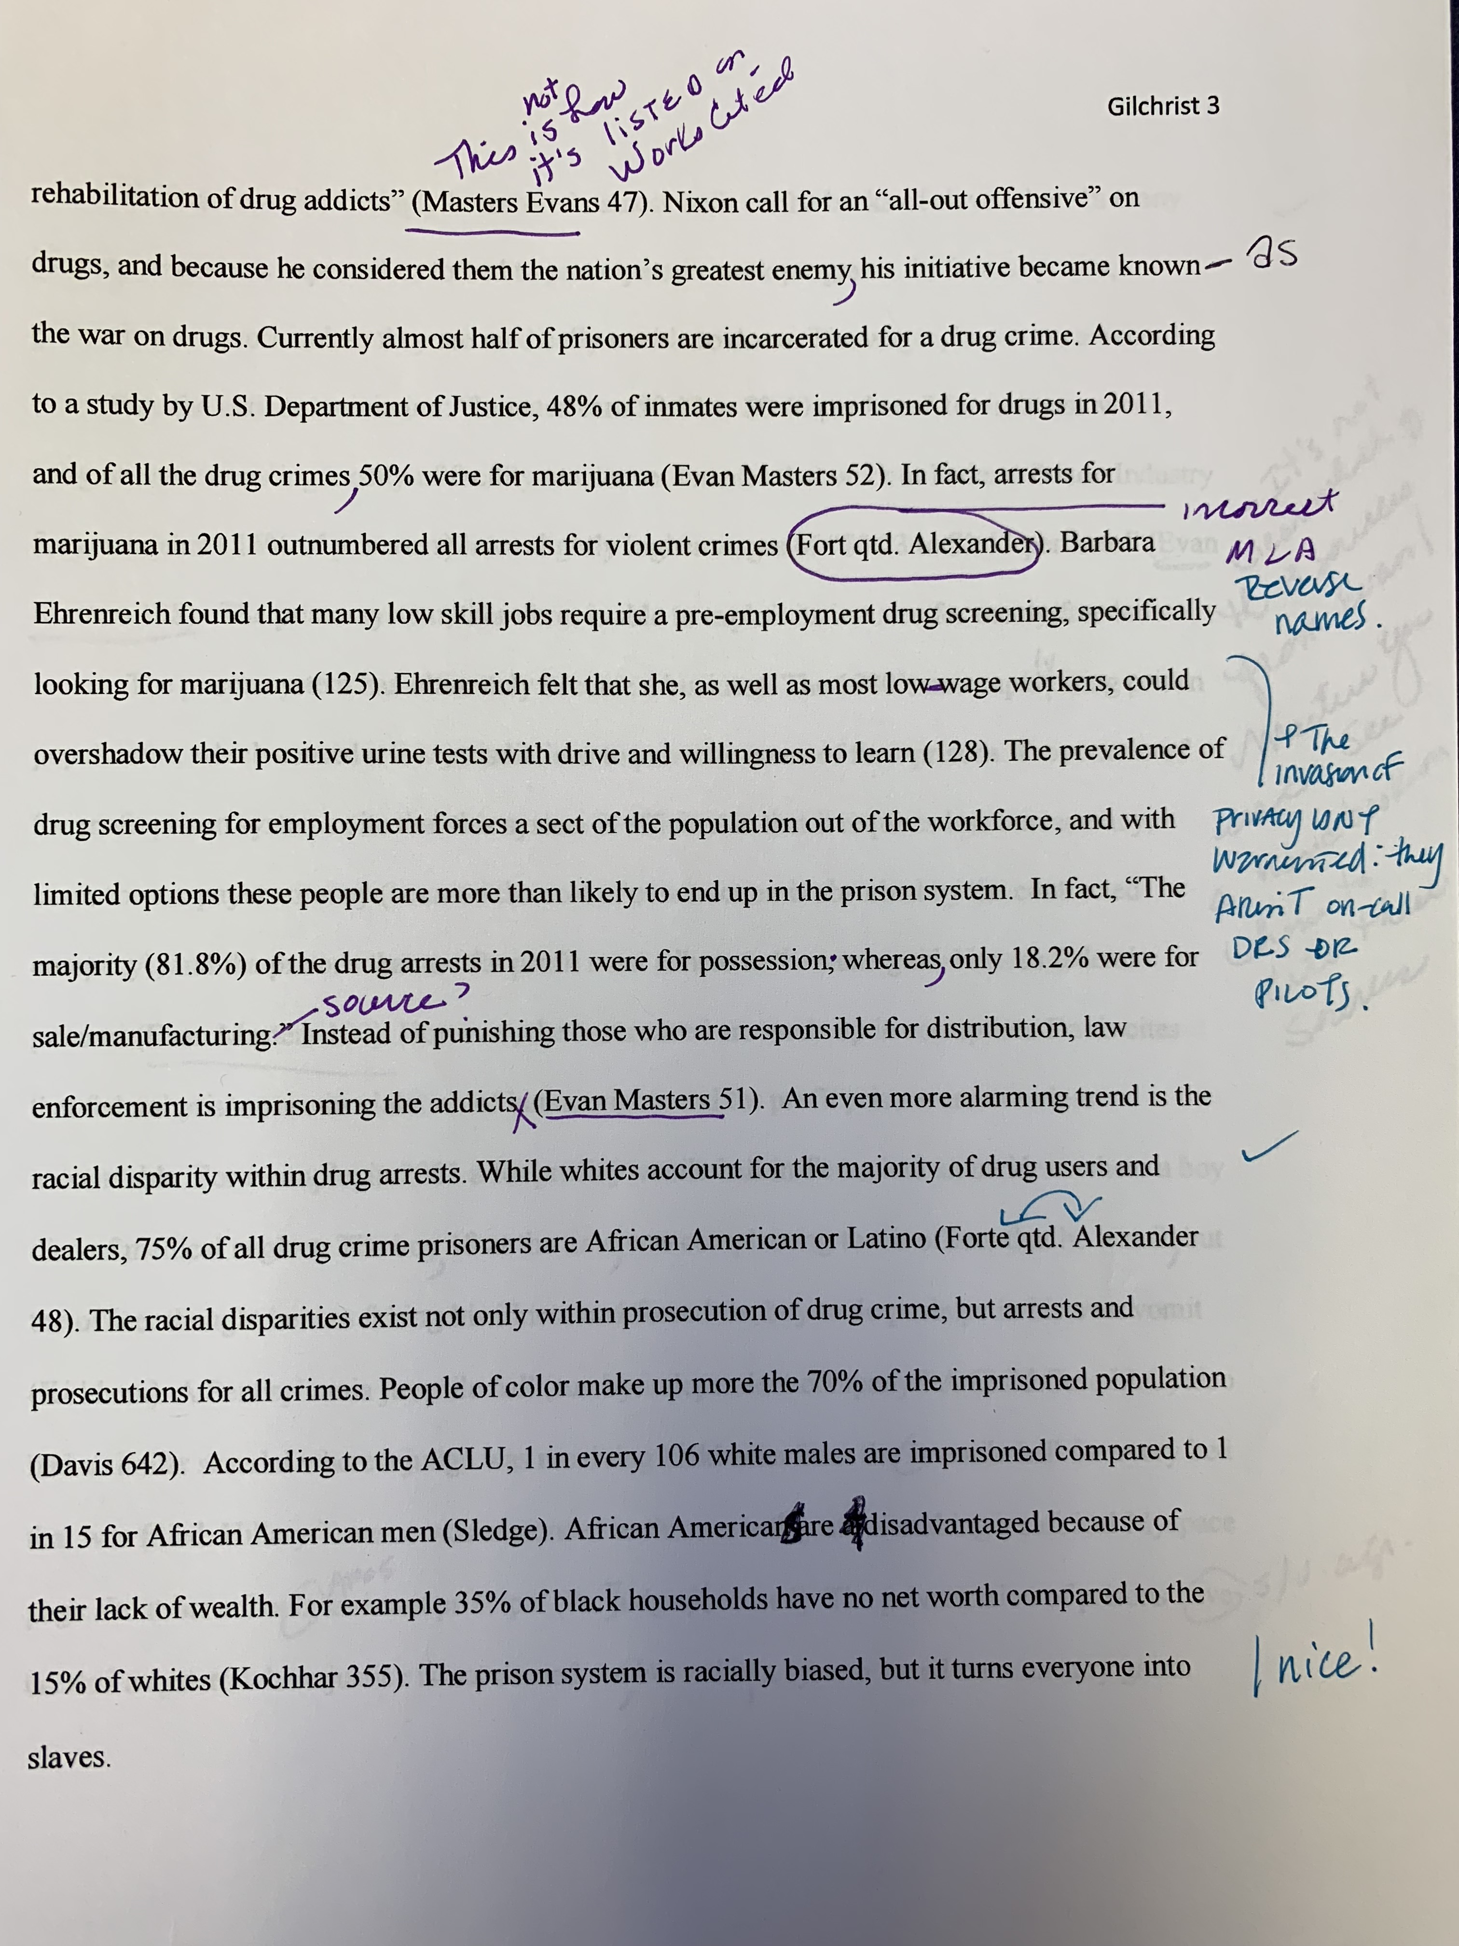
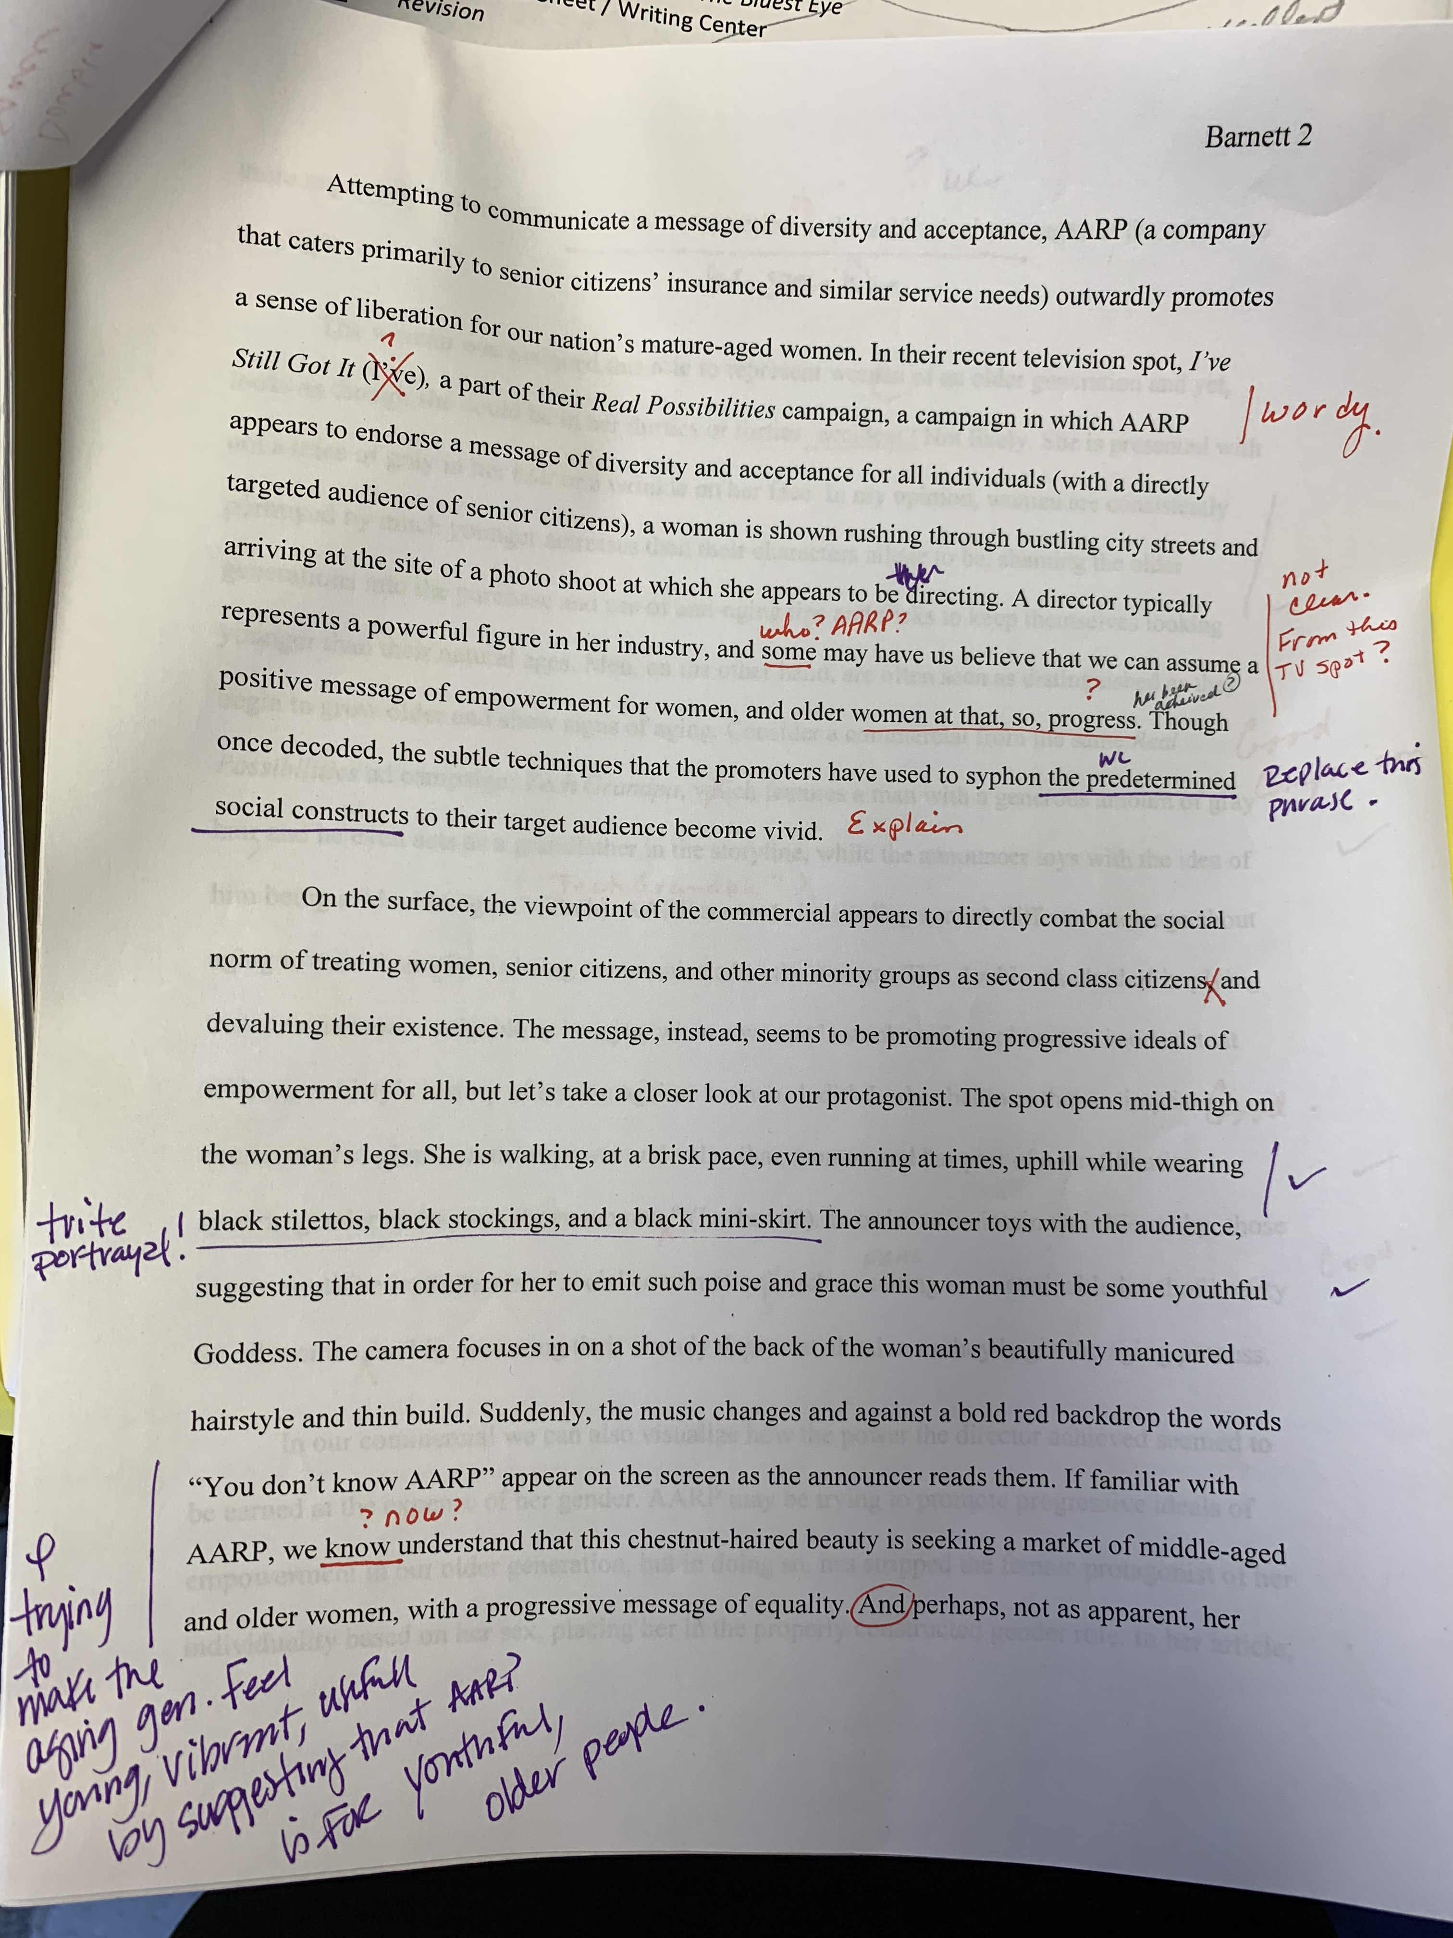
Student Evaluation

Slide 18
Global Education:
Integrated Material & Assignments
Intercultural Dialogues
CMNS 101: Communication Studies
ENGL 101: College Composition I

Slide 19
Write Talk: A Global Experience
CMNS 101: Communication Studies
ENGL 101: College Composition I
This learning community allows students to fulfill two general education requirements—one in English and one in Humanities, with a CCBC Global Designation. Students will sharpen communication skills within a supportive community of learners and explore a common global theme through writing, research, discussion, and oral presentations.

Slide 20
Integrative Material
ENGL 101
CMNS 101
In English, students read novels and other short readings related to cultural diversity and complete assignments designed to strengthen skills of analysis and critical thinking
In CMNS the assignments from ENGL are adapted for speeches. Students become aware of the differences in presenting information orally and presenting information through writing.
Both use similar planning strategies, research, organizing, outlining, and documentation

Slide 21
Integrative Assignments
ENGL 101
CMNS 101
Cultural Autobiography (must conduct personal interview)
Moral Dilemma Paper
Summary Response to journal article (research sources to prepare for Research Paper)
Research Paper on Human Rights issue
Personal culture speech (must incorporate a visual aid).
Moral Dilemma Speech
Sources and summaries from ENGL are used to prepare research speech
Research Speech Human Rights issue

Slide 22
Sample Integrative Assignment
Moral Dilemma Essay and Speech
  Based on the novel The Kite Runner by Khaled Hosseini – two choices:
  Describe an incident in your own life where you, like Amir, faced a moral dilemma where you had to make an important, life-altering decision. How did the decision affect you? What was the lesson you learned?
  Describe a burden that you carry or have carried. Explain how this burden has affected or changed your life, what were the consequences, and what was the lesson you learned? How have you gained strength from this experience?

Slide 23
Intercultural Dialogues
International/ESOL Students visit classes in various disciplines or speak at campus events.
This program facilitates an open exchange between individuals with different cultural backgrounds.
Students enrolled in the courses are able to ask the international students questions.

Slide 24
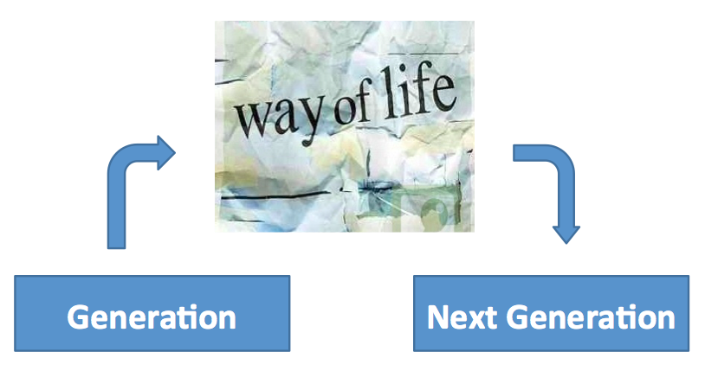
Advantages of Intercultural Dialogs
  Students learn the meaning of culture,
  build meaningful relationships,
  engage in reflection,
  & challenge themselves to be more culturally relative rather than ethnocentric
Notes:
Amy

Slide 25
Learning Communities and Academic Development Courses
ACDV 101: academic development & ENGL 101: College Composition I
ACDV 101: academic development & ACLT 101: academic literacy

Slide 26

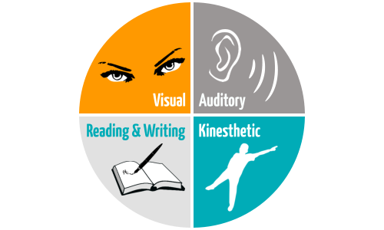


The ACLT/ACDV Learning Community
The ACLT/ACDV learning community helps students improve their reading and writing skills while fulfilling developmental reading and developmental English requirements.
Students will fulfill the ACDV requirement using the materials and assignments from the ACLT 052 course as they develop and strengthen the academic skills needed to become successful college students.
Notes:
Deborah

Slide 27
ACDV 101/ ENGL 101:
College Consciousness: Exploring the Role of Education in Today’s Society
In this Learning Community students explore the role of education in society and reflect on their own educational goals as well as acquire the knowledge and skills to successfully navigate a variety of educational paths. Students apply ACDV strategies necessary for success in the college environment to master the course objectives in their English Composition 101 course.

Slide 28

contact Information:
Cheryl Scott: cscott2@ccbcmd.edu
Amy R Wilson: awilson@ccbcmd.edu

